Slide 1






LET’S TALK TO GOD!
MODULE 4

Slide 2

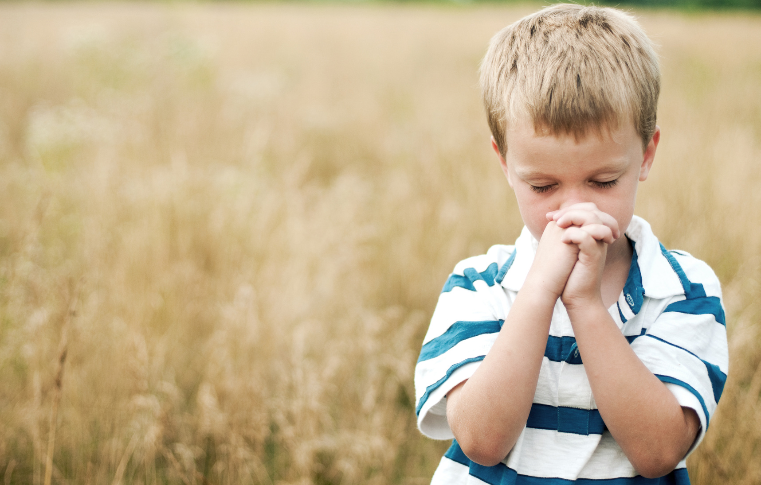


PRAYER ISN’T JUST ABOUT TALKING; IT’S ABOUT LISTENING, TOO.

Slide 3


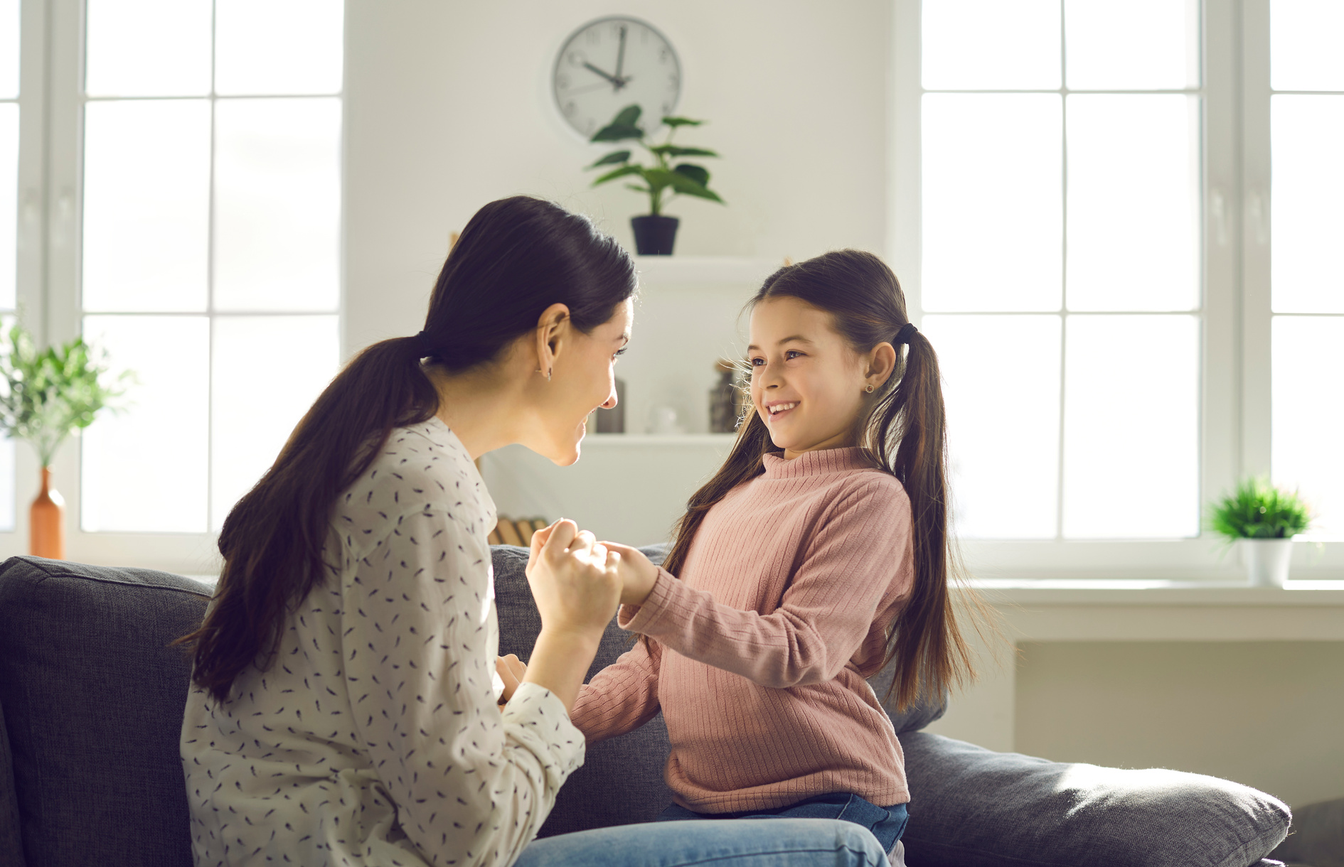


Have you ever talked to someone you love—like a parent or a best friend—and felt peace just because they listened?
That’s what prayer is like with God! Prayer is simply talking to God about anything, anywhere, anytime.

Slide 4


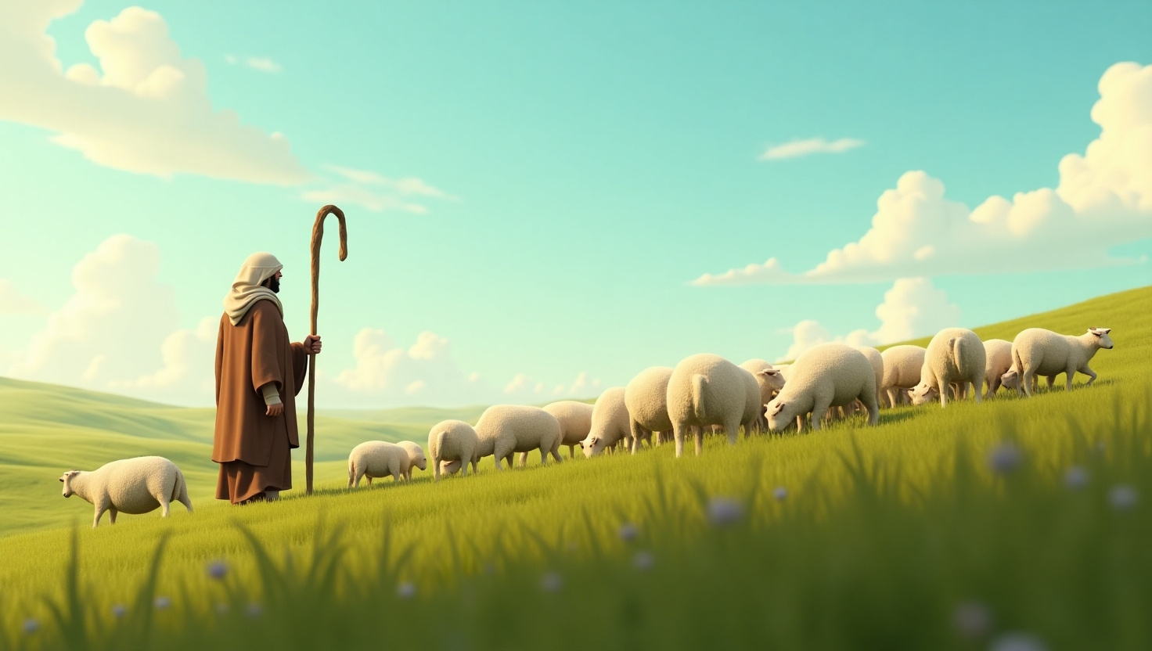

THE SHEPHERD’S CALL
In the hills of Judea, a shepherd watches over his flock

Slide 5
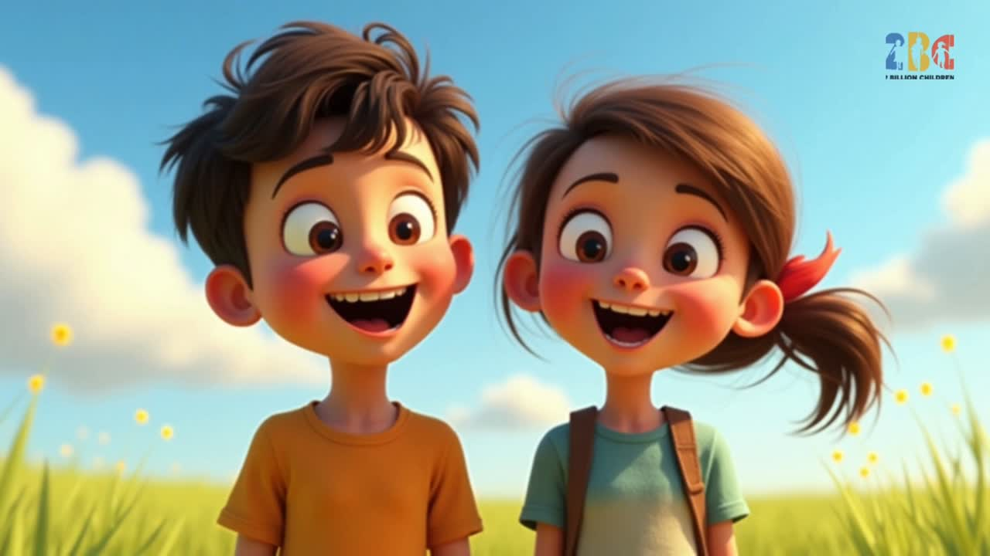

Slide 6
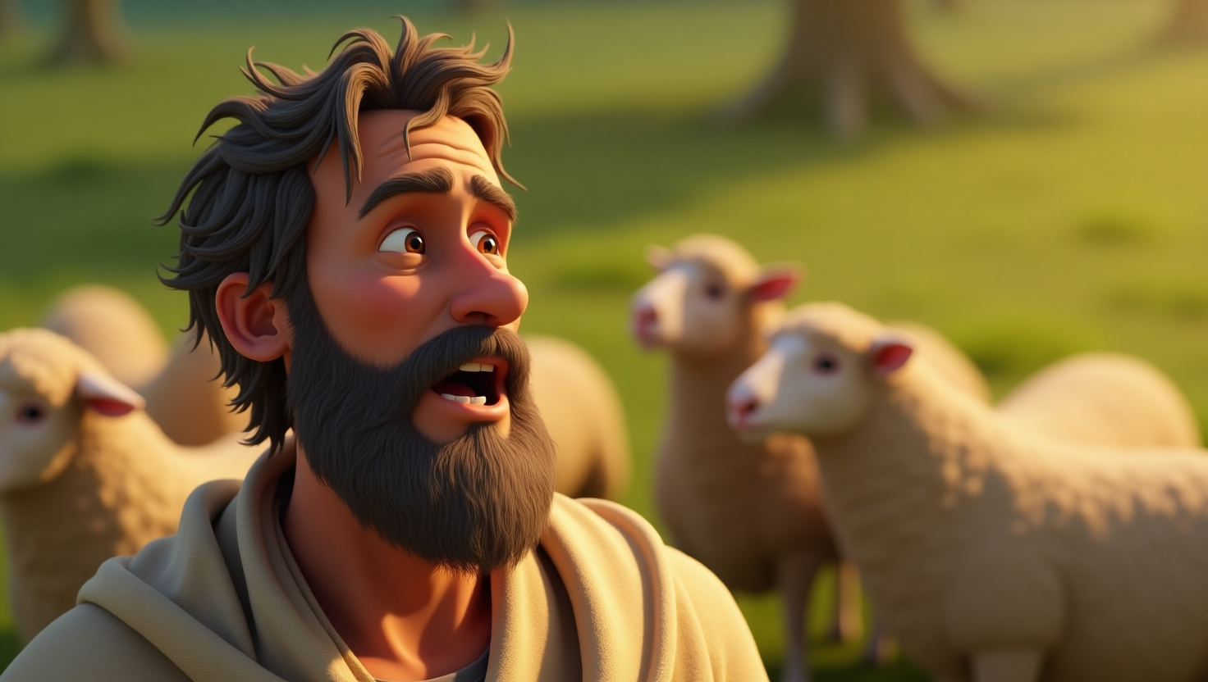
THE SHEPHERD’S VOICE
He calls to them, his voice steady and familiar.

Slide 7
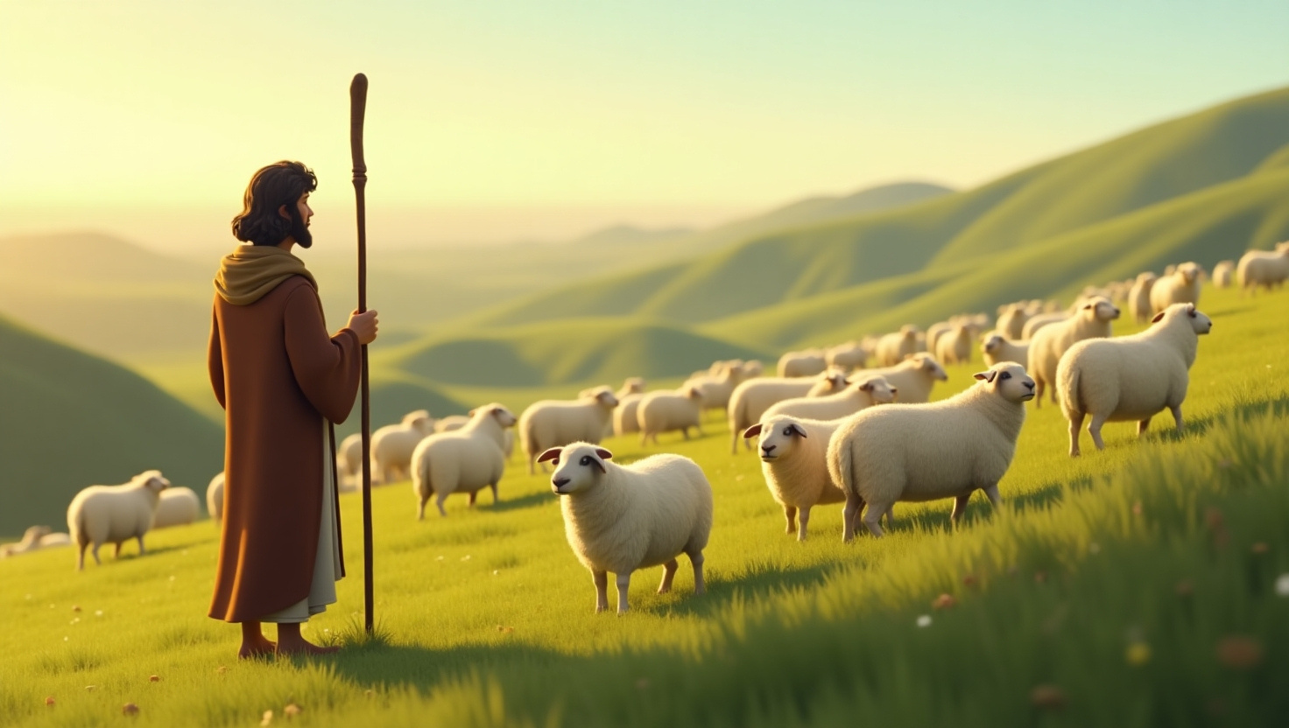
THE SHEEP RESPOND
The sheep know him—they listen only to his voice.
Jesus said, “My sheep listen to my voice” (John 10:27). That means you can hear Him too!

Slide 8
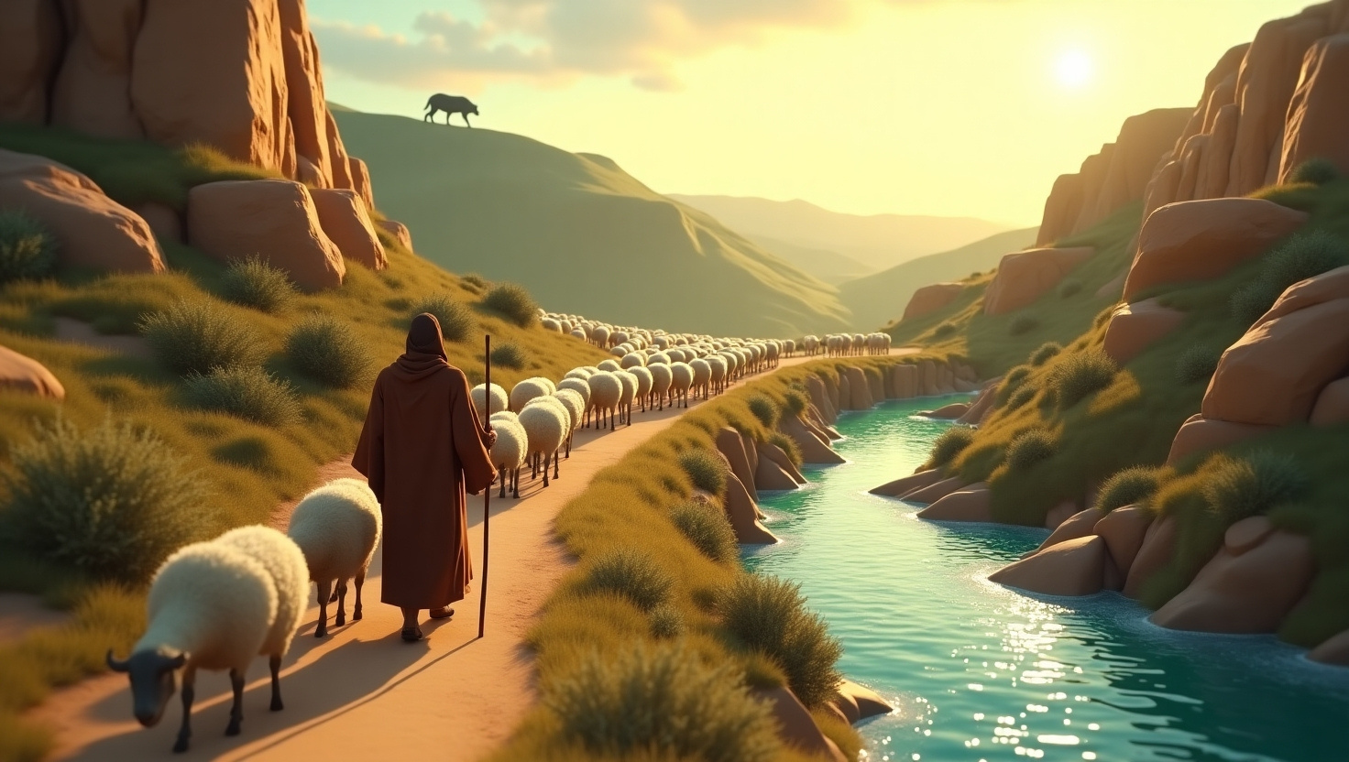
THE JOURNEY BEGINS
Through danger and peace, they follow where he leads.

Slide 9
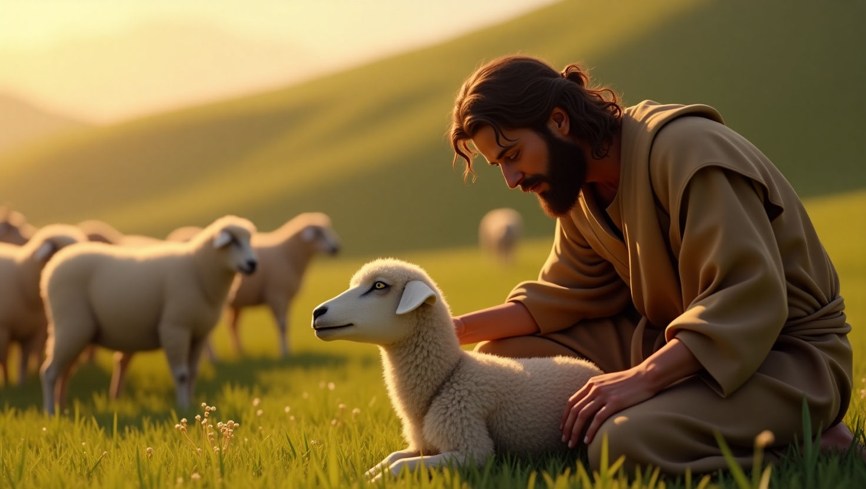
THE BOND
He knows them each by name, and they trust him completely.

Slide 10
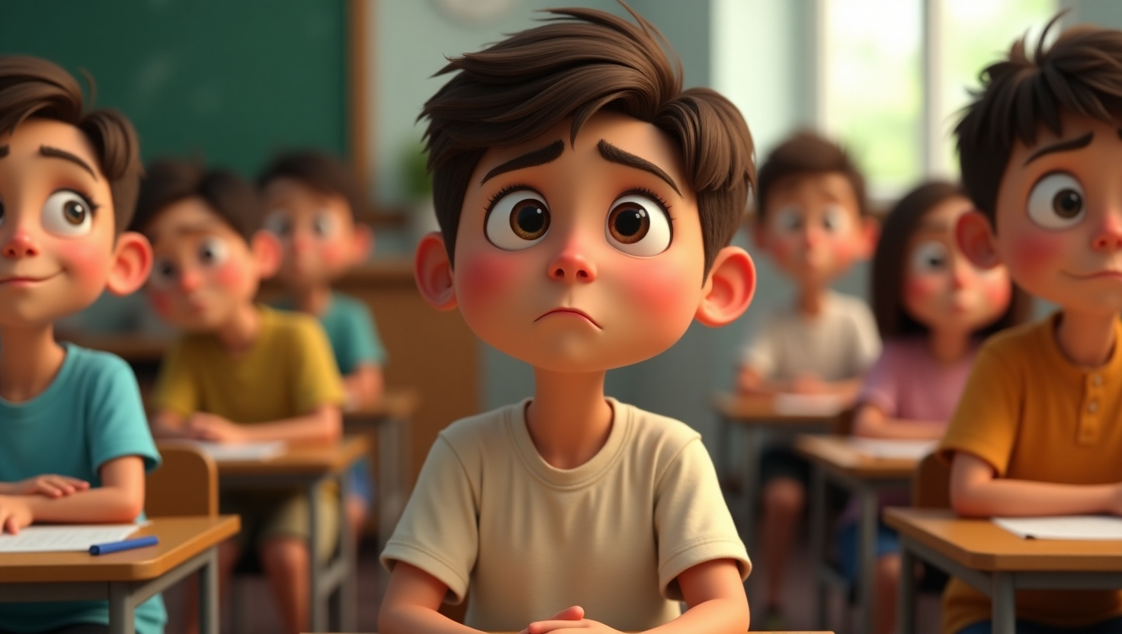



JUSTIN’S
STORY
Remember Justin?
In past lessons, we learned he sometimes struggles with speaking, but he discovered a beautiful way to share God’s love—writing cards of encouragement.

Slide 11
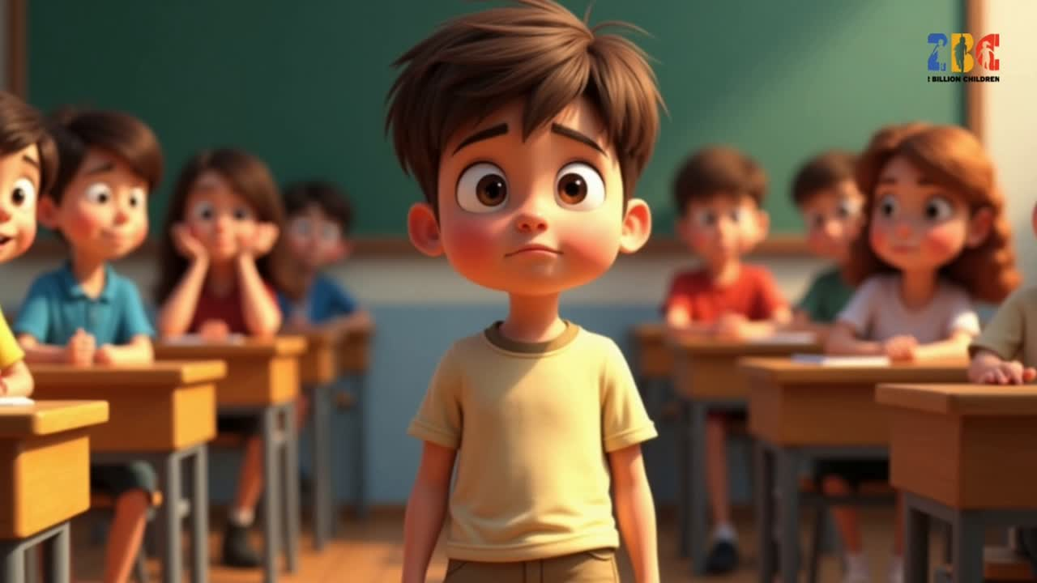

Slide 12

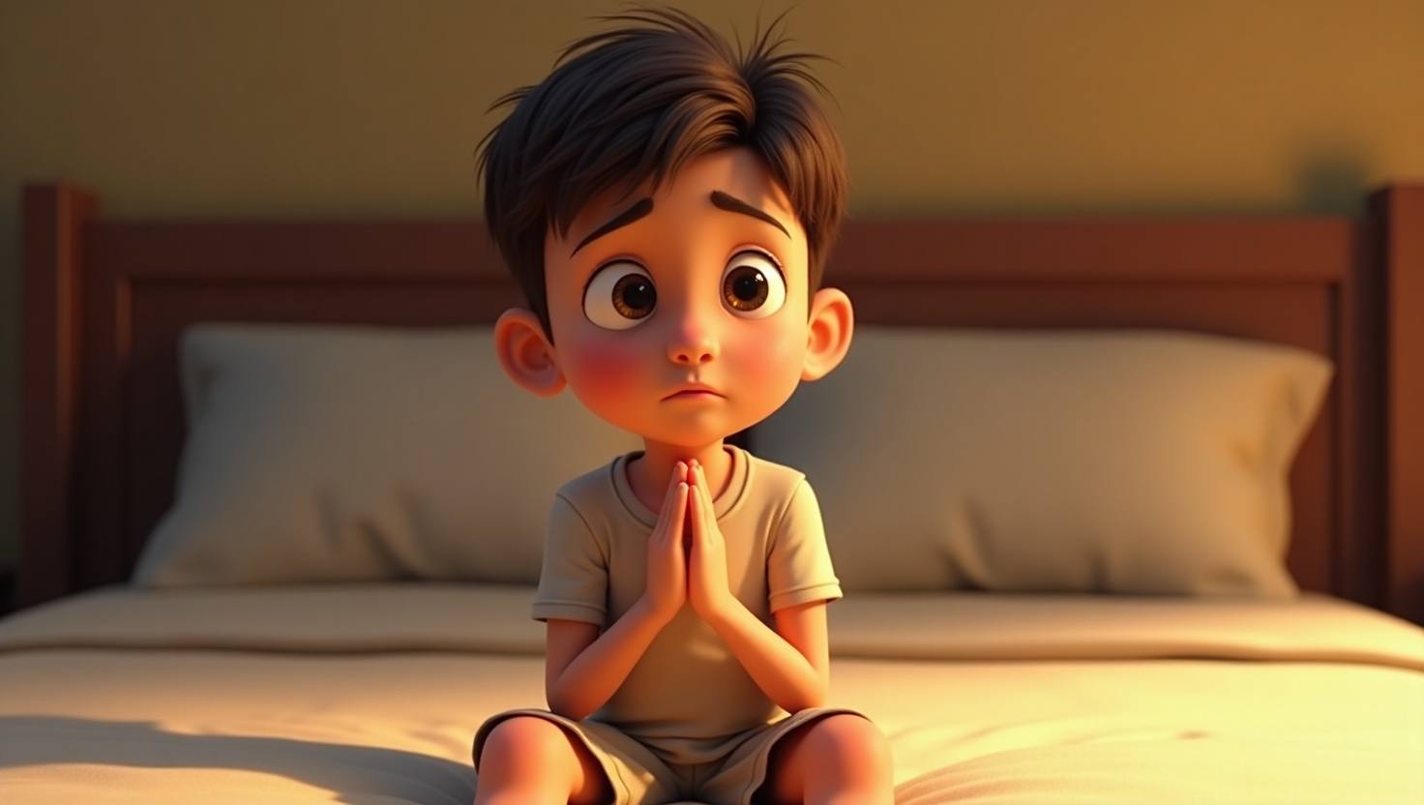

How Justin Prays :
HE THANKS GOD FOR THE PERSON’S LIFE.

Slide 13

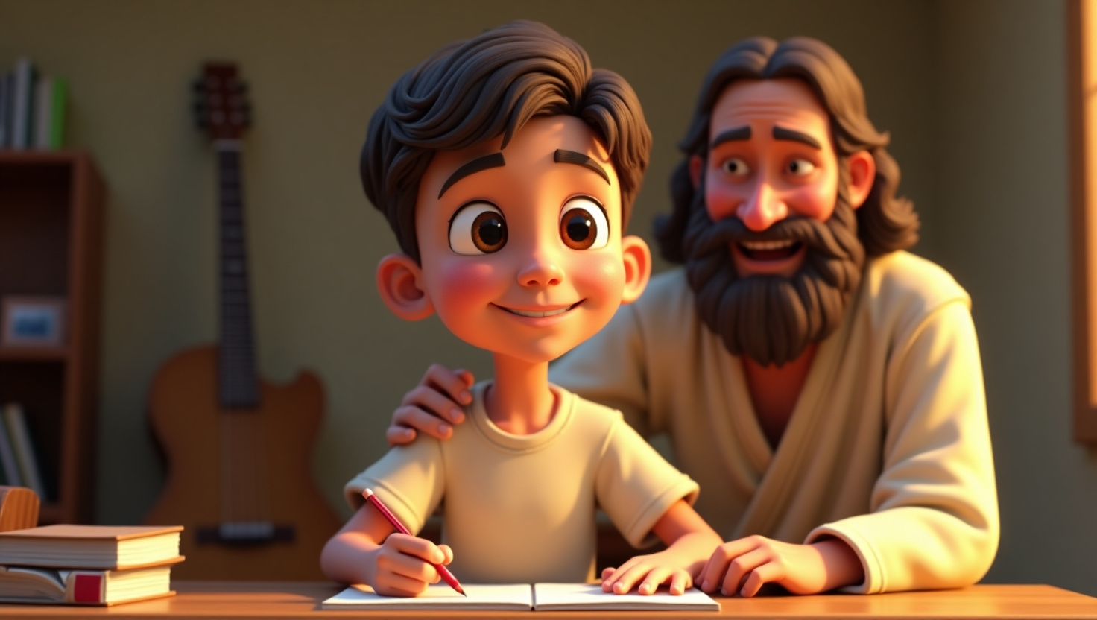

HE LISTENS FOR ANY SPECIAL MESSAGE GOD WANTS HIM TO SHARE

Slide 14

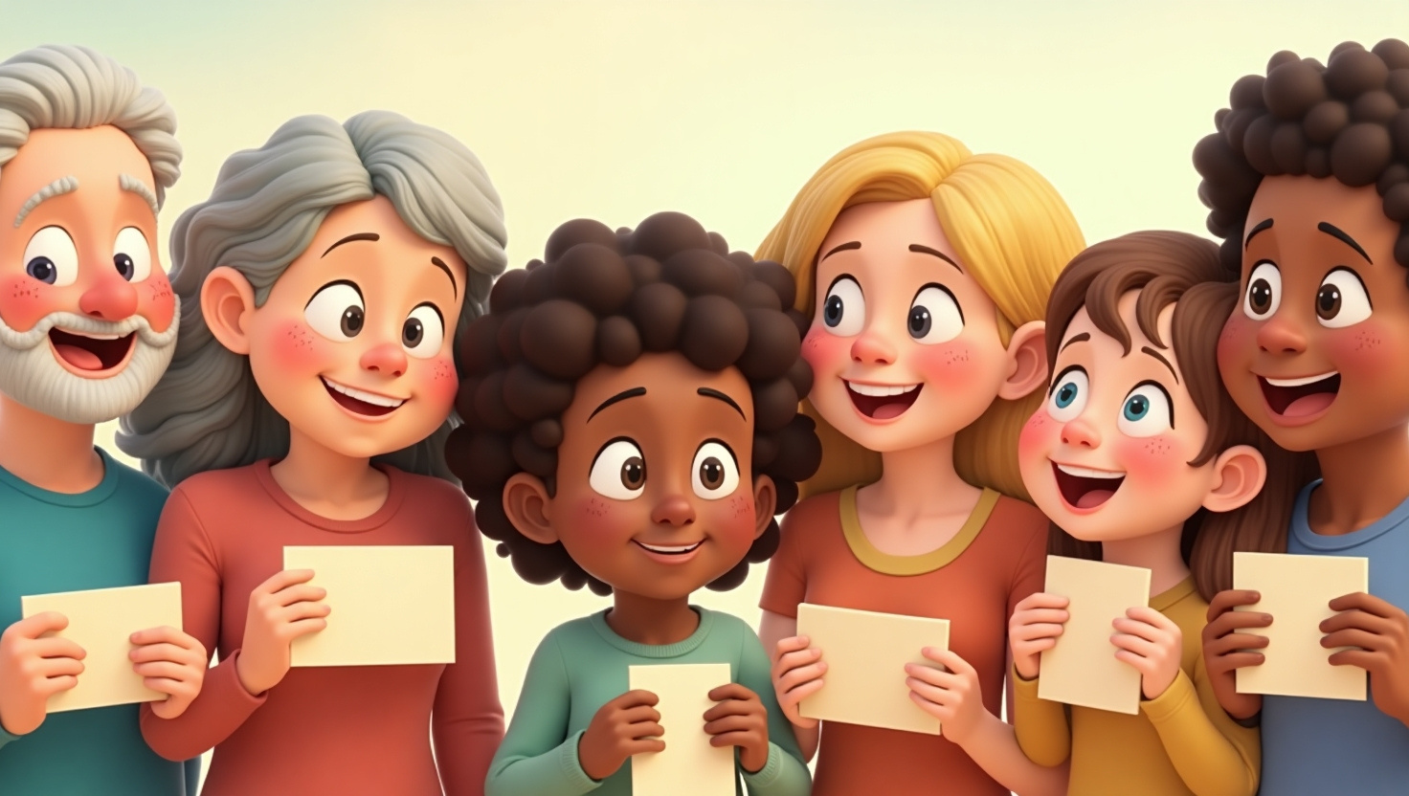
HE WRITES DOWN THOSE ENCOURAGING WORDS, THEN GIVES THE CARD TO THE PERSON.

Slide 15
JUSTIN’S STORY REMINDS US THAT PRAYER IS POWERFUL—YOU DON’T HAVE TO BE A GROWN-UP OR HAVE FANCY WORDS TO HEAR FROM GOD!

Slide 16

DEAR GOD, THANK YOU FOR MY FRIENDS. HELP ME TO SEE THEM THE WAY YOU SEE THEM. HELP ME TO SHARE A message from your heart to them. be kind.
Love, (Your Name).”

Slide 17
PRAYER ISN’T JUST ABOUT US—IT’S ALSO ABOUT LOVING OTHERS.
When we pray for someone, we’re asking God
to bless them, guide them, or heal them.
Here are some ways you can pray for people:

Slide 18


SAY THEIR NAME OUT LOUD:
“God, please help my friend ___ find peace and joy today.” Speak to them today, so they will know you are with them.

Slide 19


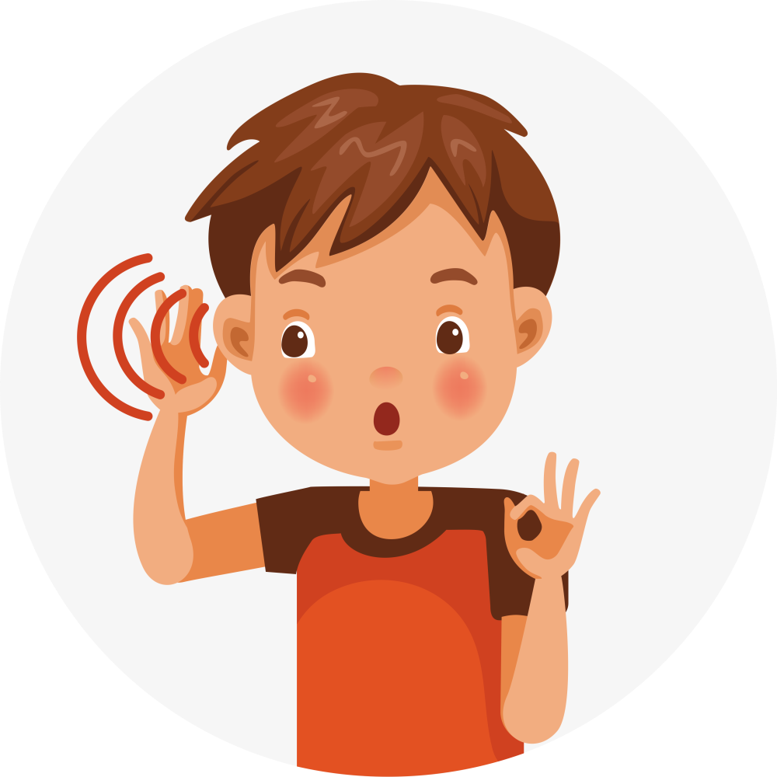
LISTEN FOR GOD’S ENCOURAGEMENT:
Maybe He’ll give you a kind message to share. If He does, you can write it down and turn it into a prayer card, just like Justin does.

Slide 20

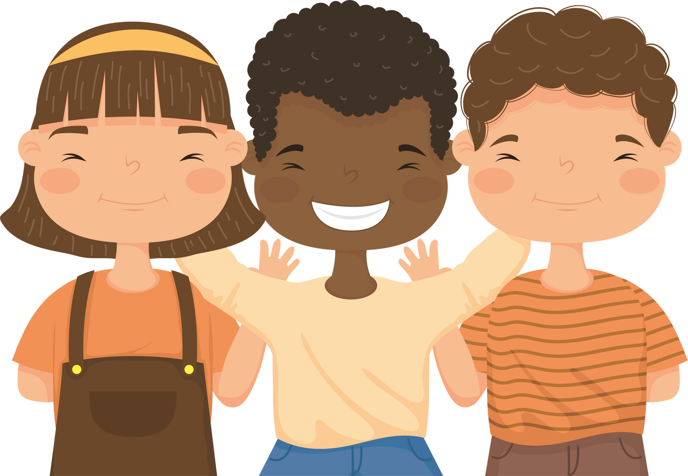


GOD MAY SHOW YOU ANOTHER WAY TO SHARE HIS LOVE
—like being a special friend or giving someone a warm smile.
When we pray for others, we’re showing God’s love in action!

Slide 21



PRAY FOR 5.”
Ask God to Help You Identify Up to Five People
Write Their Names Down
Pray for Each Person
Listen for God’s Voice

Slide 22





GET READY FOR THE NEXT LESSON!
We’ll learn more about living out God’s love every day!
SHARING GOD’S LOVE TOGETHER

Slide 23



