Slide 1






Module1
G
O
D
S
P
E
A
K
S
:
H
E
A
Can you
?
R
H
I
M

Slide 2



ARE YOU READY TO LEARN ?
LET’S GET STARTED!

Slide 3

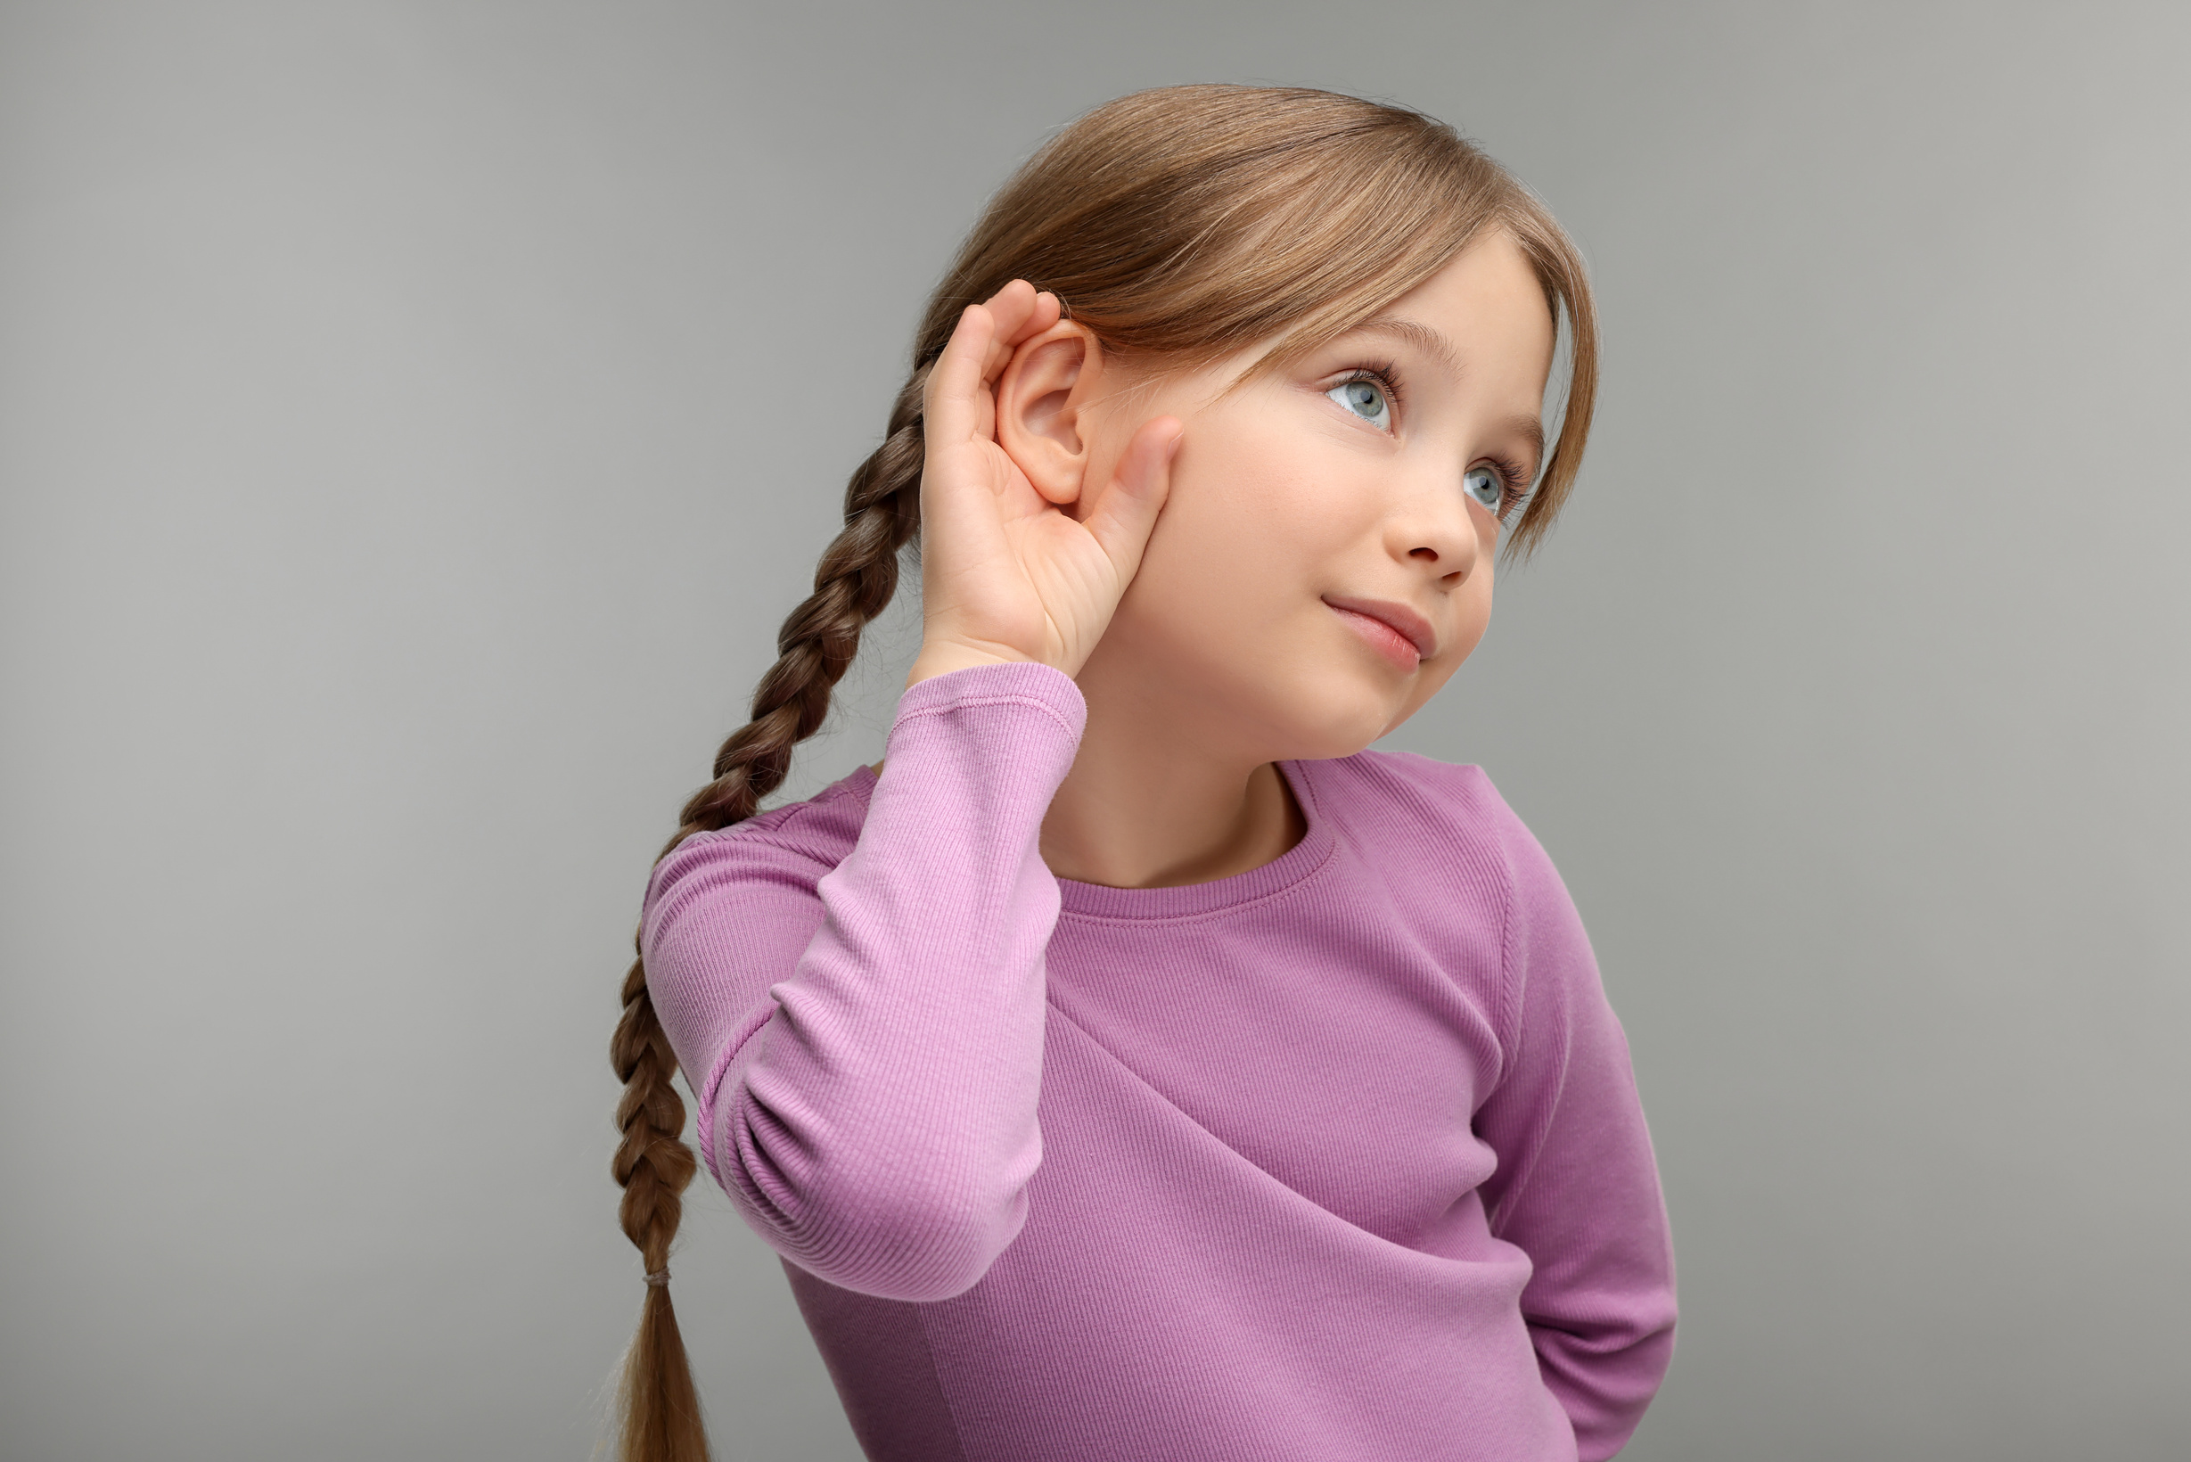

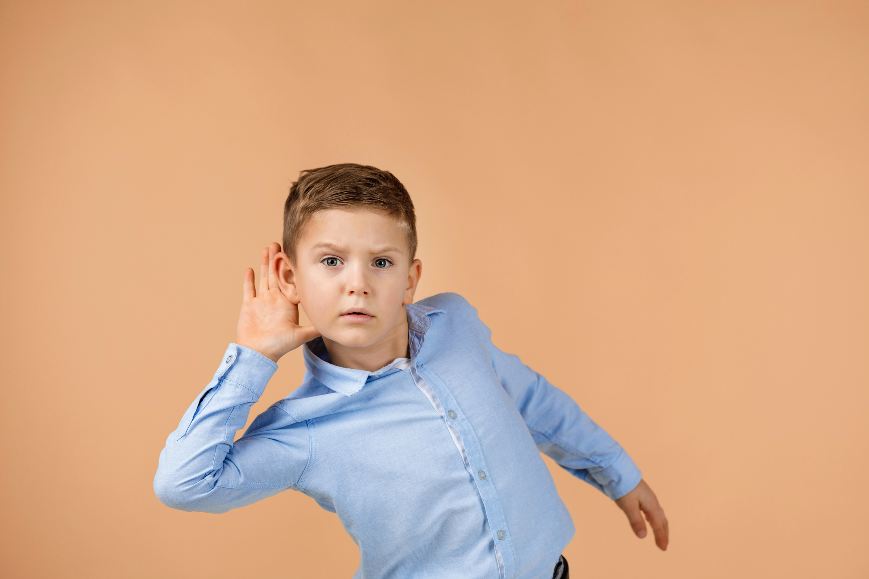
GOD IS STILL SPEAKING
Life can be noisy, and it’s easy to miss God’s gentle voice. But just like He spoke to people long ago, He wants to speak to you today—like a loving Father or a best friend who truly
cares.

Slide 4

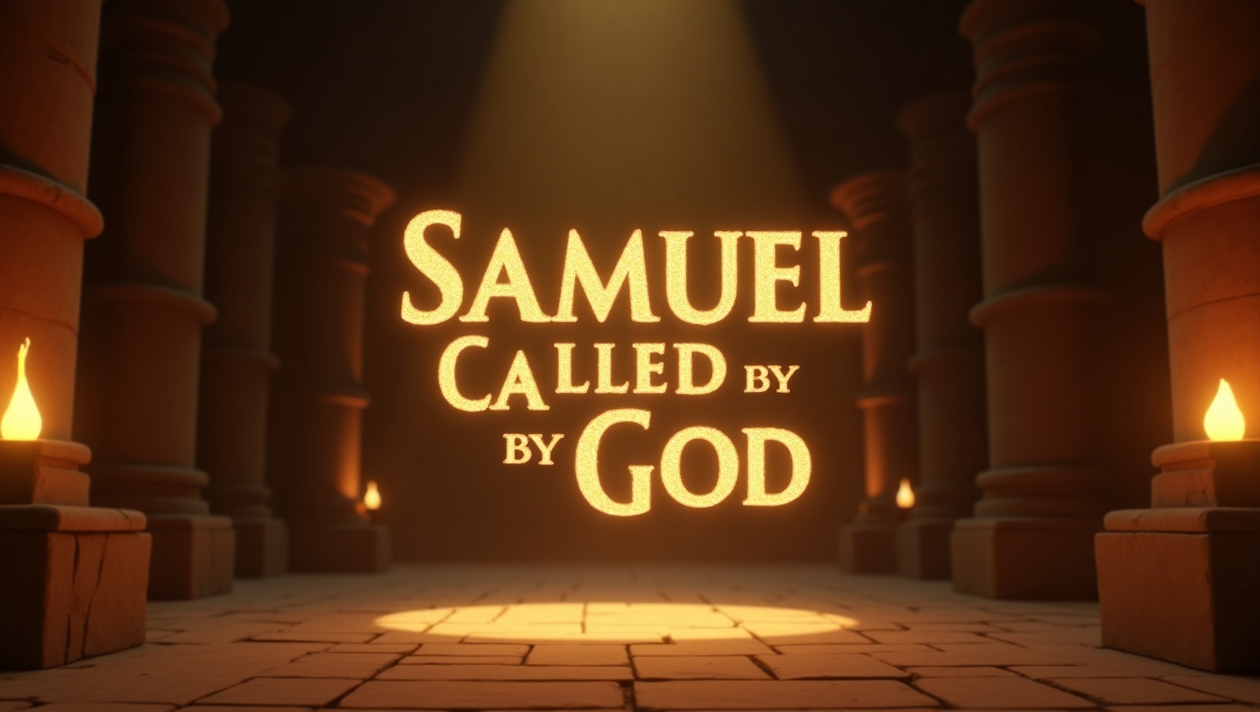
LET’S HEAR
A STORY!

Slide 5


Slide 6
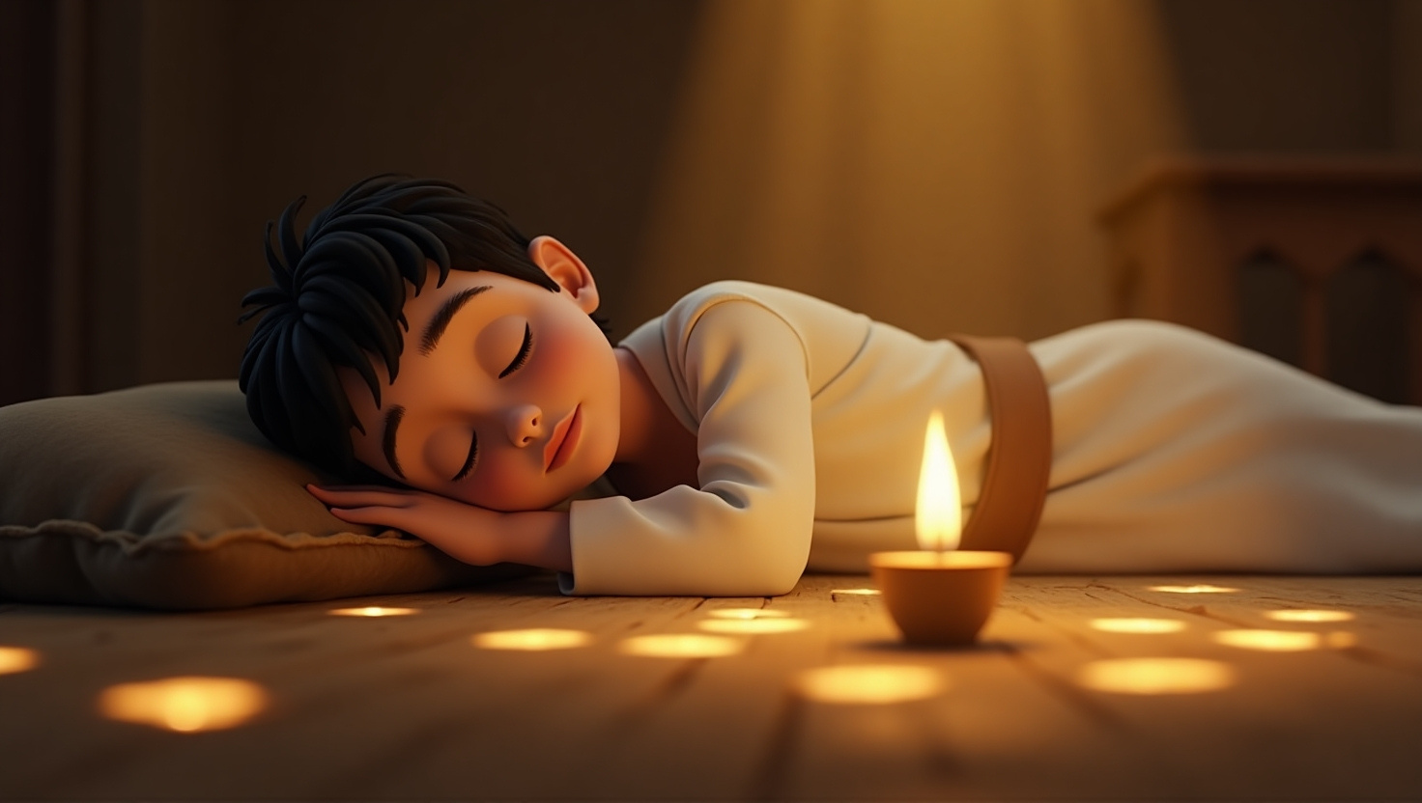


You’re lying down in a dimly lit room. It’s quiet and All. Suddenly, you hear someone calling your name—so yet powerful, like a warm breeze. That’s exactly what happened to a young boy named Samuel.

Slide 7

Samuel lived in a special place called the tabernacle, where people worshiped God. He served under a priest named Eli, who taught others about God. One night, as Samuel was drifting off to sleep, he heard a voice saying, “Samuel… Samuel.”

Slide 8
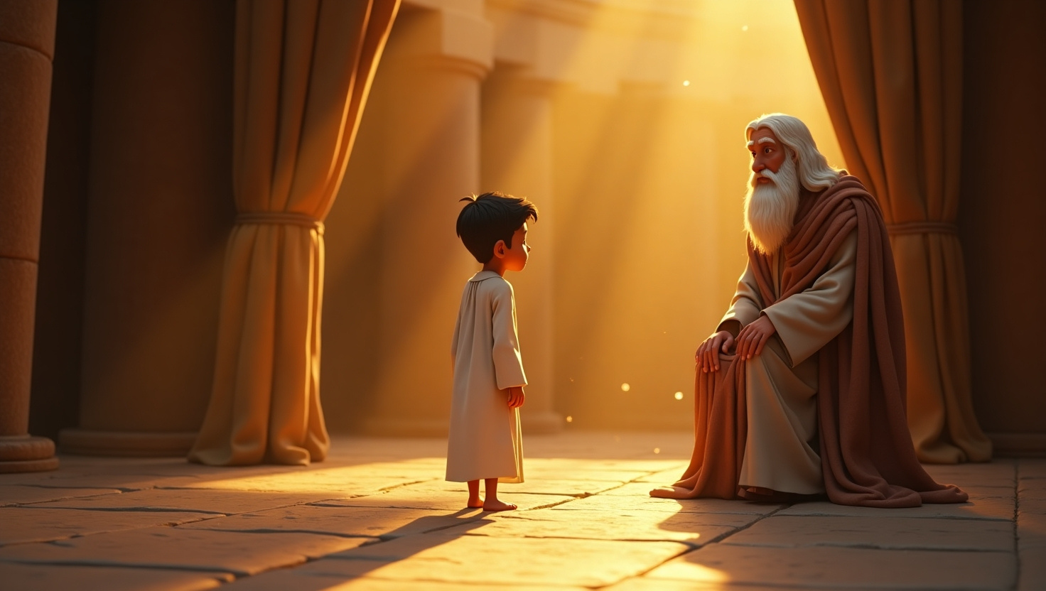
This happened again and again. After the third time, Eli realized something amazing: it wasn’t a person calling Samuel—it was God! So Eli told him, “The next time you hear that voice, say, ‘Speak, Lord, for your servant is listening.’”

Slide 9


WHAT CAN WE LEARN FROM SAMUEL’S STORY?
God can speak
to anyone—even kids.

Slide 10

WHAT CAN WE LEARN FROM SAMUEL’S STORY?
We must be ready to listen

Slide 11

WHAT CAN WE LEARN FROM SAMUEL’S STORY?
When we truly hear God’s voice, everything changes

Slide 12


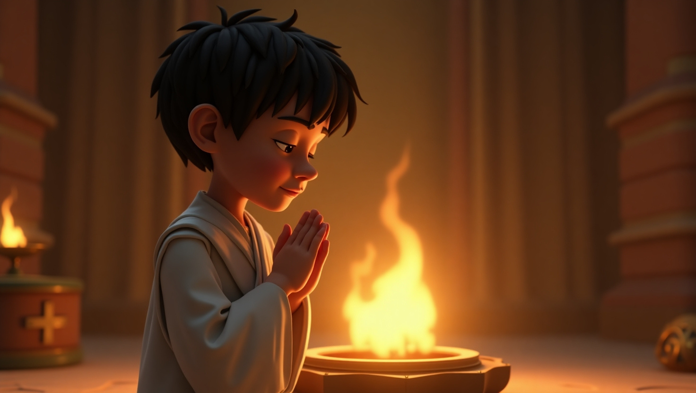
If God called your name right now,
HOW WOULD YOU ANSWER?
Close your eyes for a moment. Imagine you’re Samuel, lying in a peaceful, quiet space. Suddenly, you hear your name. How would you feel—surprised? Excited? Maybe a bit nervous?

Slide 13

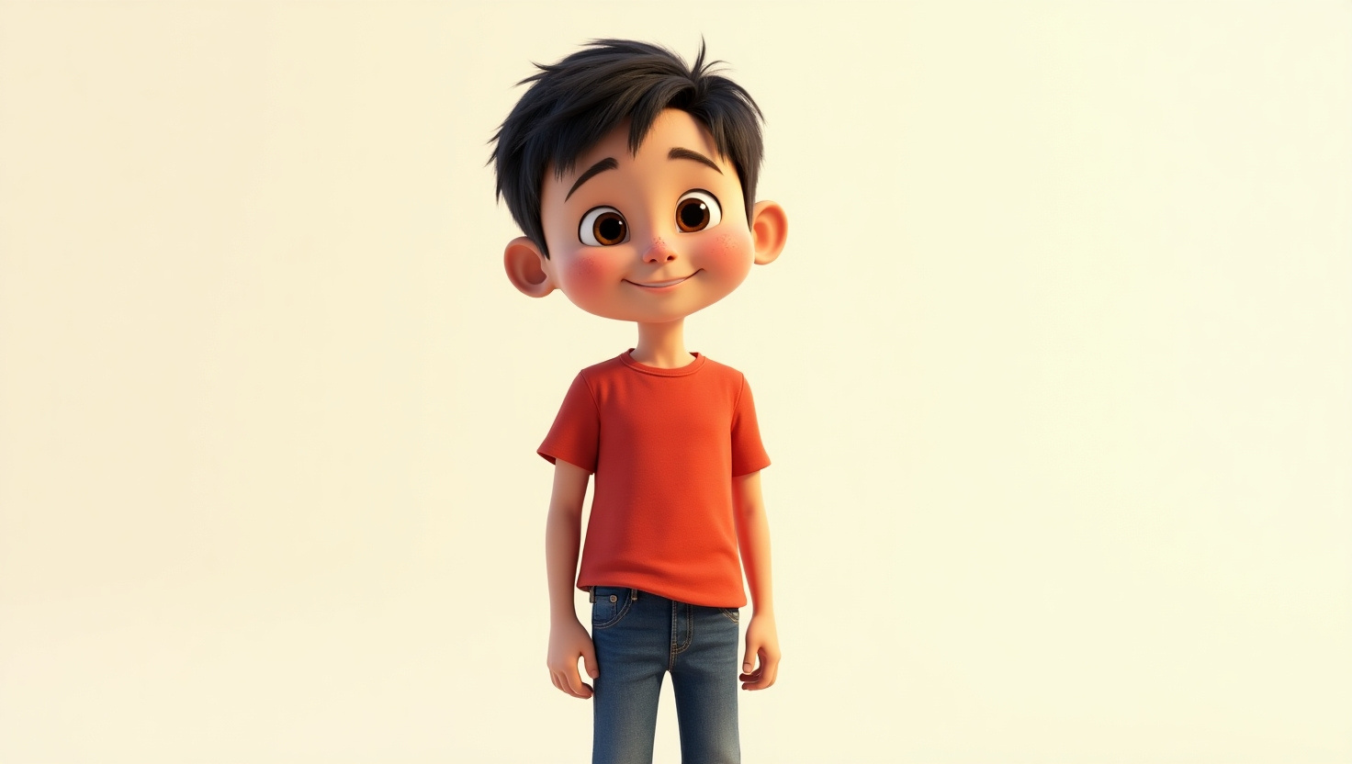

JUSTIN’S STORY

Slide 14
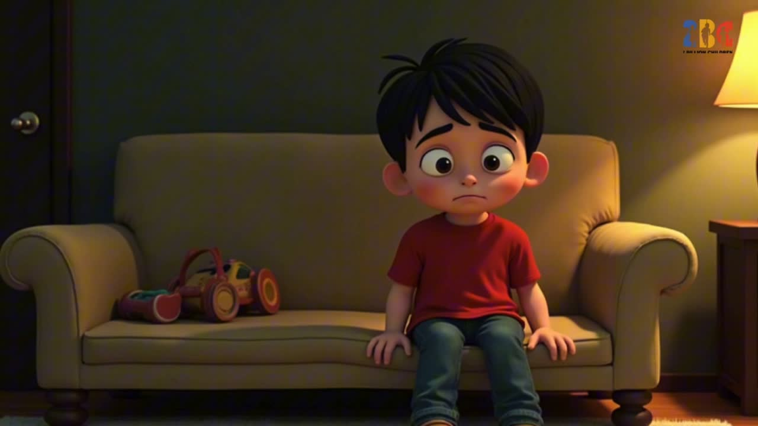

Slide 15

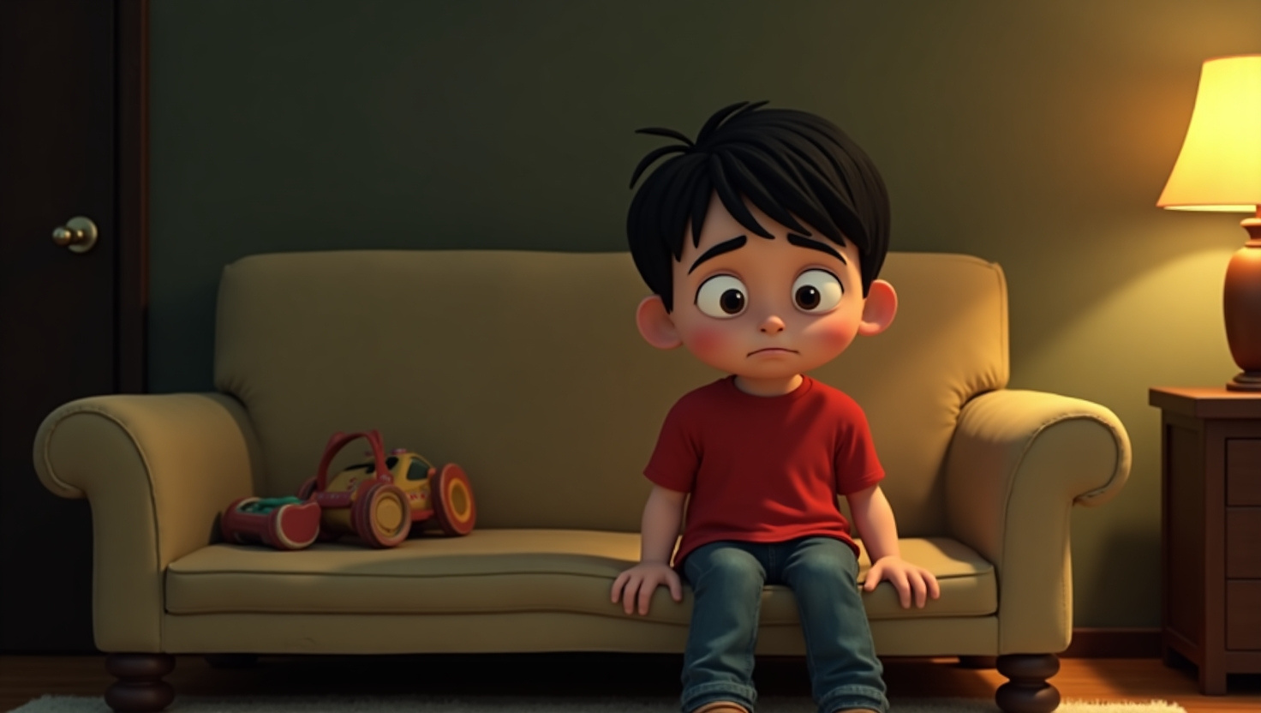


Meet Justin, a young boy who has learned to hear God’s voice in a unique way. Justin is on the autism spectrum, which sometimes makes verbal communication challenging for him to speak
with words. But that hasn’t stopped him from hearing God’s gentle whispers in his heart.

Slide 16

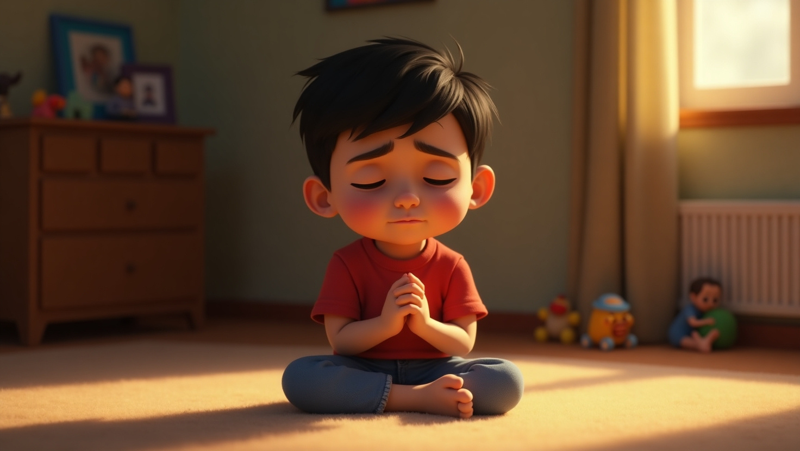
One day, as Justin prayed quietly, he felt God speaking to his heart: “It’s okay to be different because I have a big purpose for you.”

Slide 17
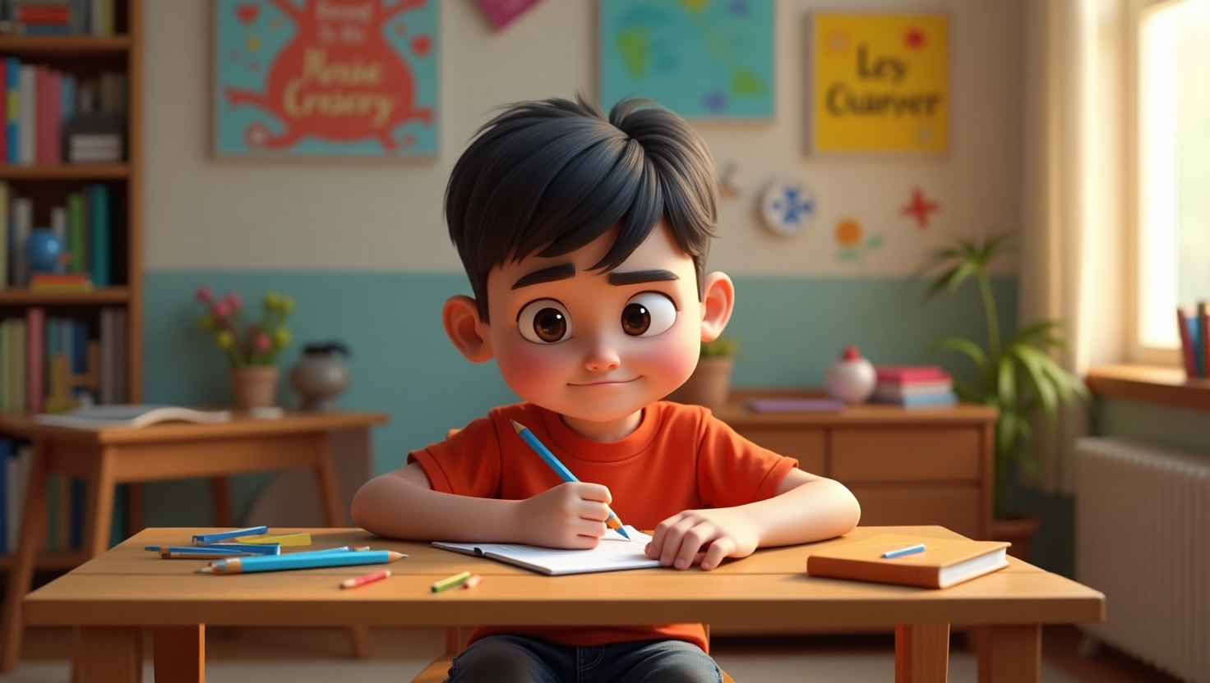

Over time, he wrote messages of encouragement, hope, and love - touching his friends, family, and even strangers.

Slide 18

Justin believes everyone can hear God’s voice
Just like Samuel, Justin discovered that God speaks to anyone who’s willing to listen, no matter how old they are or how they communicate. Justin believes everyone can hear God’s voice if they open their hearts. And when they do, it lifts them up and reminds them of their unique purpose.

Slide 19



What do you think God might be saying to you?”
That could be God speaking to you, like a best friend who truly knows you, or a loving Father who cares about every detail of your life. Just like Samuel, God wants to speak to you.

Slide 20





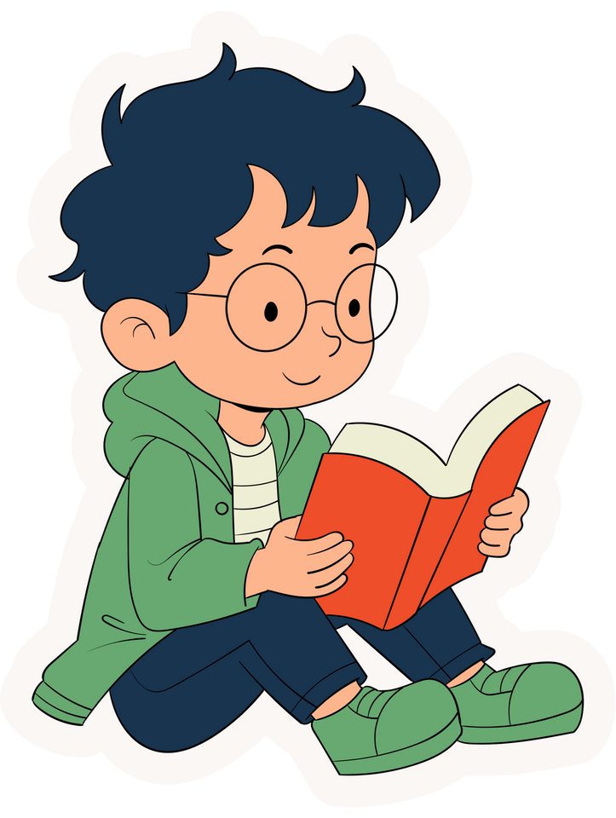


God might speak to you when you:
Read His Word
Pray and Listen
Worship Him

Slide 21

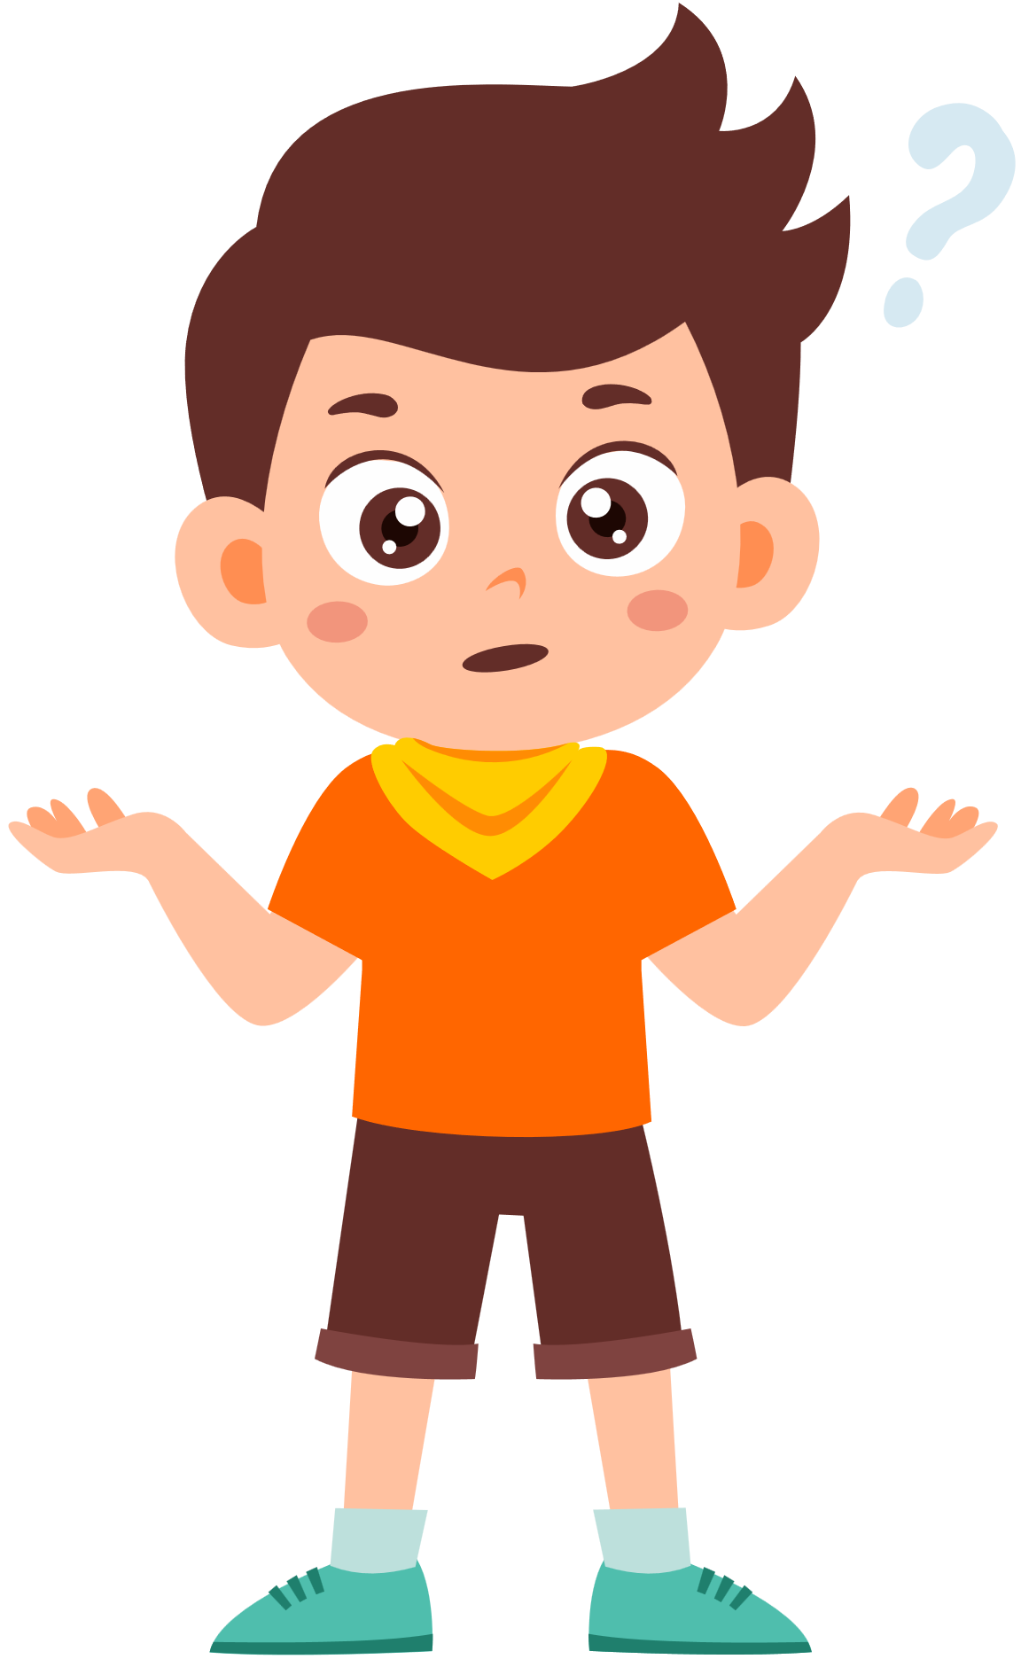

You might feel a word pop into your mind—
like “hope,” “forgive,” or “love.”
You might feel peace inside, He might remind you of a friend or family member, or you might not notice anything at first—and that’s okay!
Sometimes God speaks in His own time, and simply being still brings us closer to Him.

Slide 22



Stay tuned for the next module!”
You’re a Champion, and
God Has BIG Plans for You!

