Slide 1












MODULE 2
YOU’RE A CHAMPION!
GOD HAS BIG PLANS FOR YOU

Slide 2





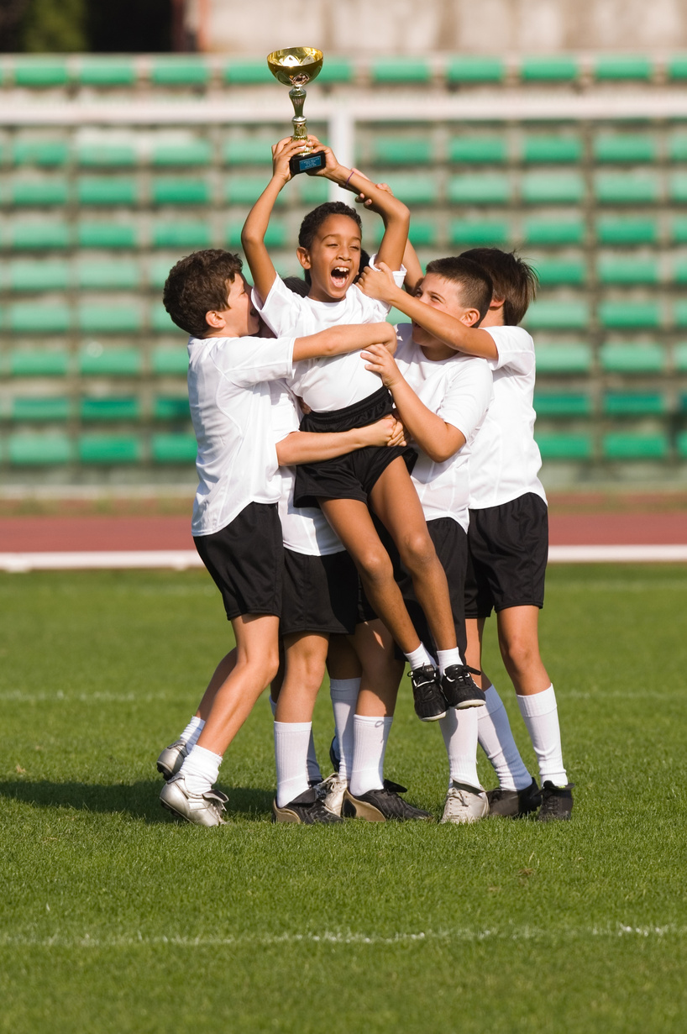



HAVE YOU EVER THOUGHT OF YOURSELF AS A CHAMPION?
Sometimes we think only grown-ups or sports stars can be champions. But guess what?
Jesus says you are a champion in God’s family!

Slide 3
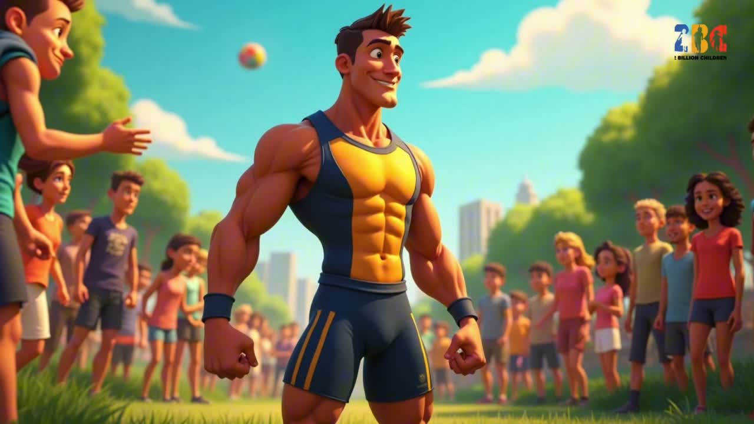

Slide 4
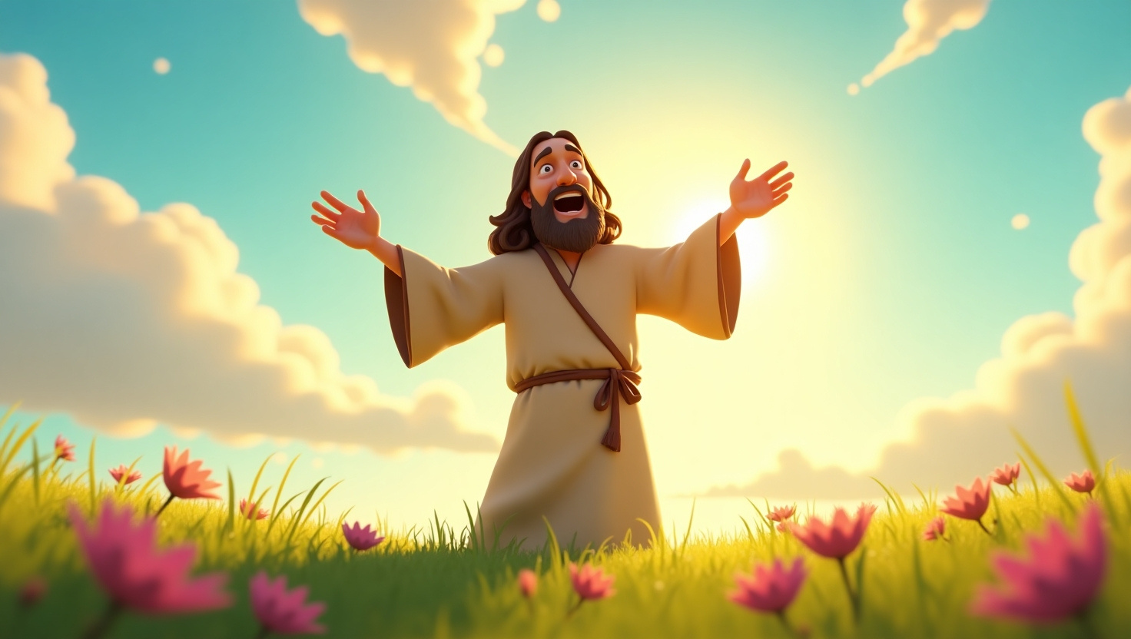


JESUS
THE TRUE CHAMPION
Jesus invites you to come close to Him.
In fact, He said,
“Let the little children come to me. Don’t stop them! The kingdom of heaven belongs to them” – (Matthew 19:14) –

Slide 5
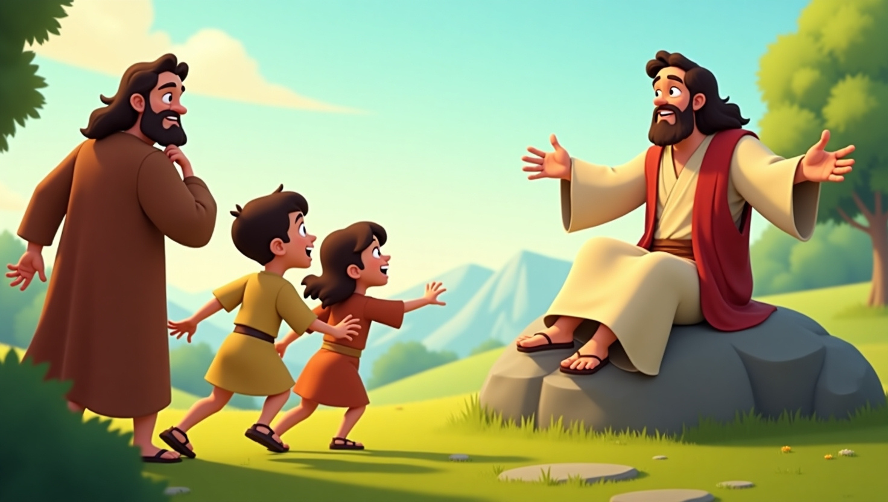

HE LOVES YOU
Jesus loves you so much that He never wants anything to stand between you and Him.
When He said, “Let the little children come to me,” He showed everyone that children are precious to God.

Slide 6
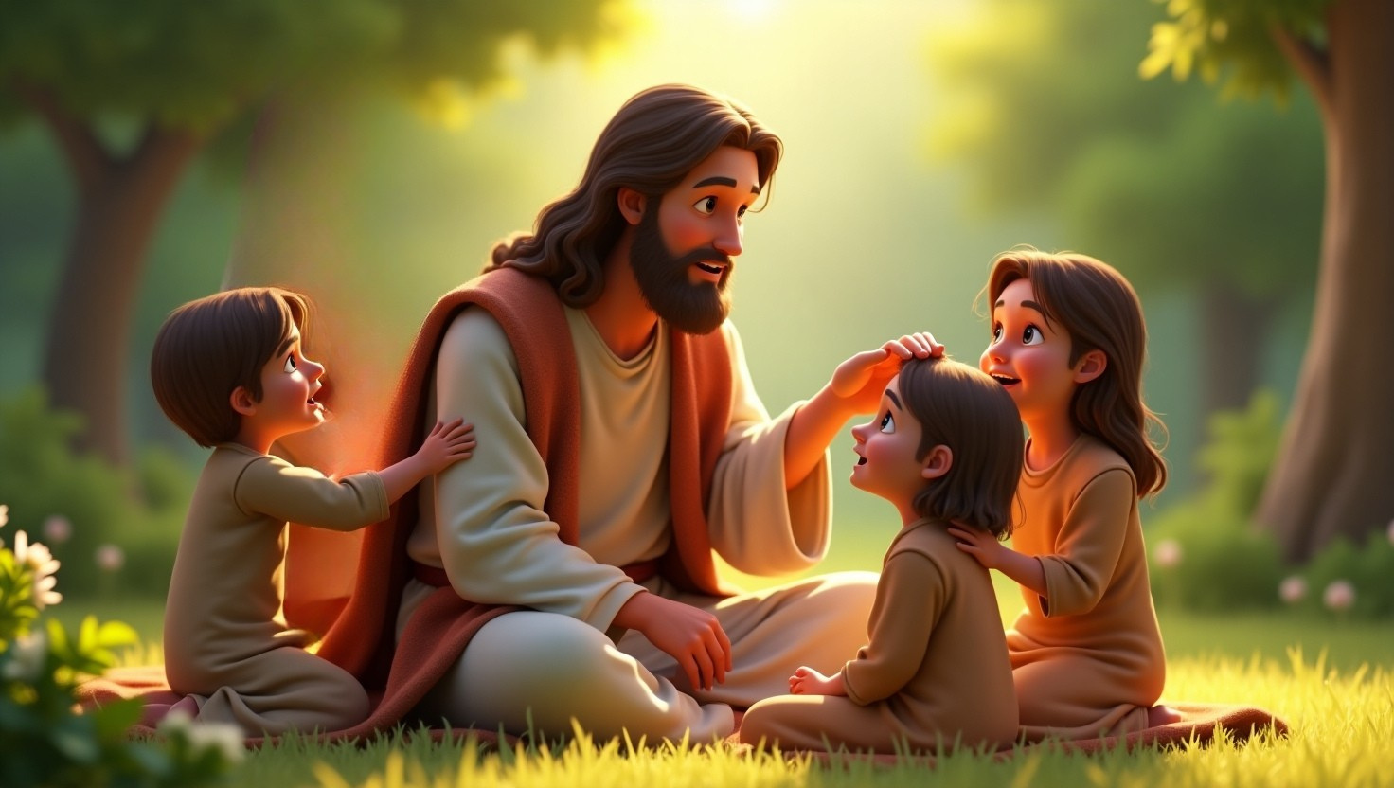
HE’S BELIEVES
IN YOU
Jesus sees all the amazing gifts inside you.
He knows the wonderful things you can do—even things you don’t know yet!

Slide 7
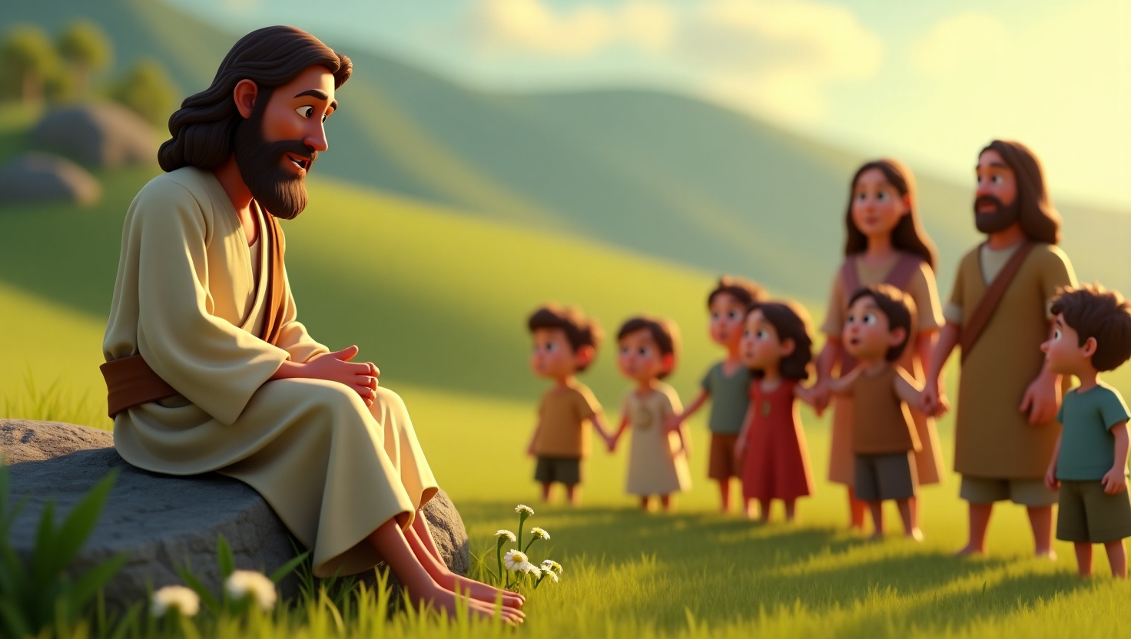
HE CALLS YOU
TO FOLLOW
Jesus once said, “My sheep listen to my voice; I know them, and they follow me” (John 10:27).
Think about that—He wants you to hear His voice and follow Him, just like Samuel did in
our first video.

Slide 8



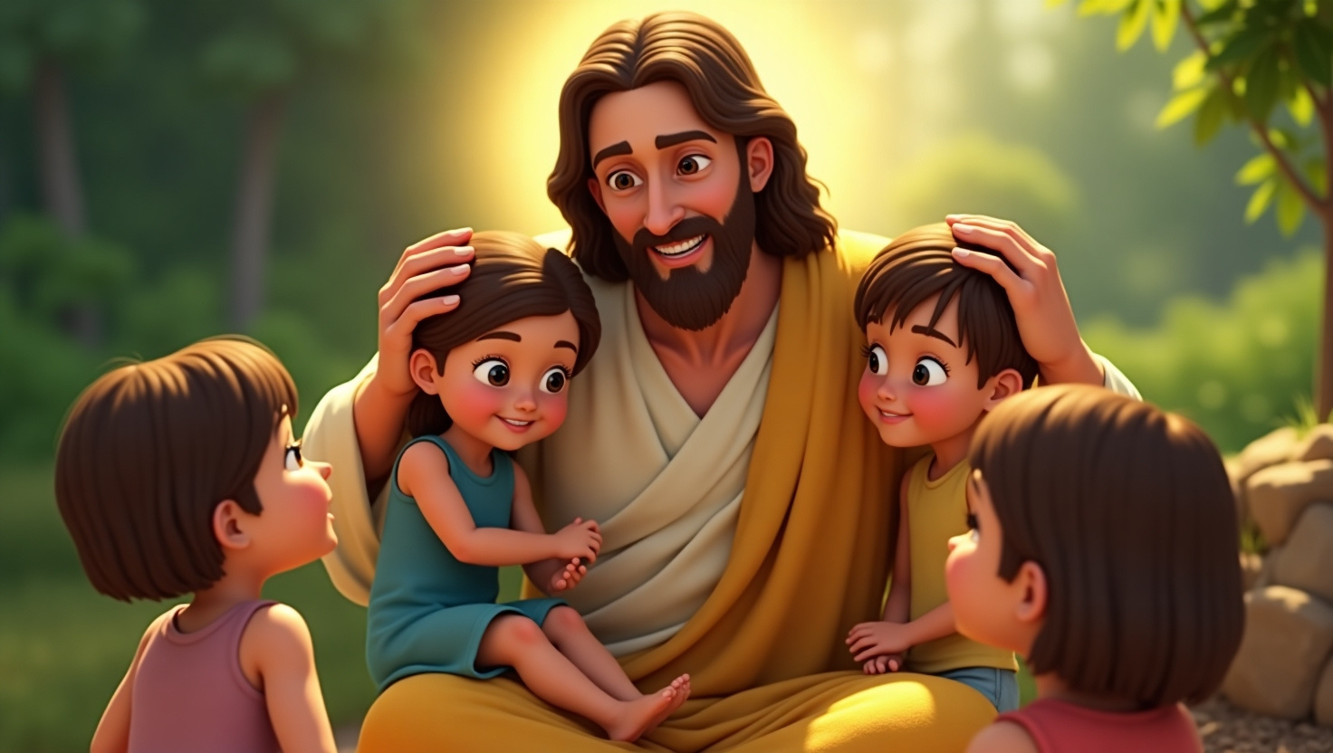



I WANT YOU
ON MY TEAM!
How does it feel to know that Jesus, the greatest Champion, believes in you and wants you on His team as part of His family?
He has big plans for your life!

Slide 9
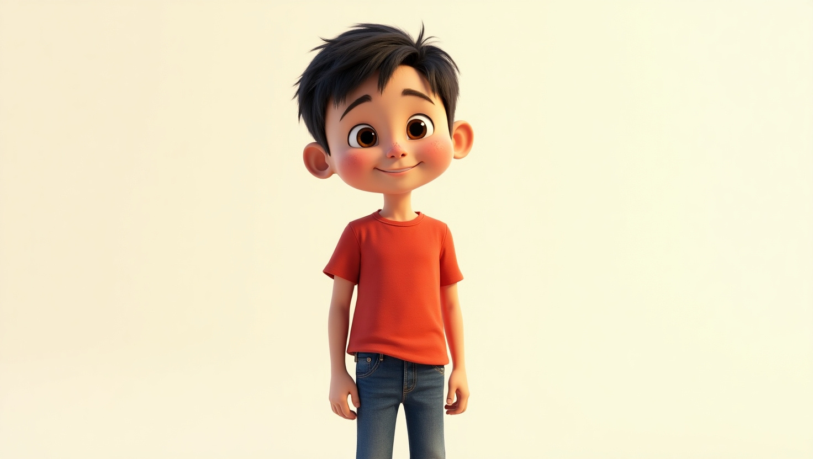

JUSTIN’S
STORY

Slide 10
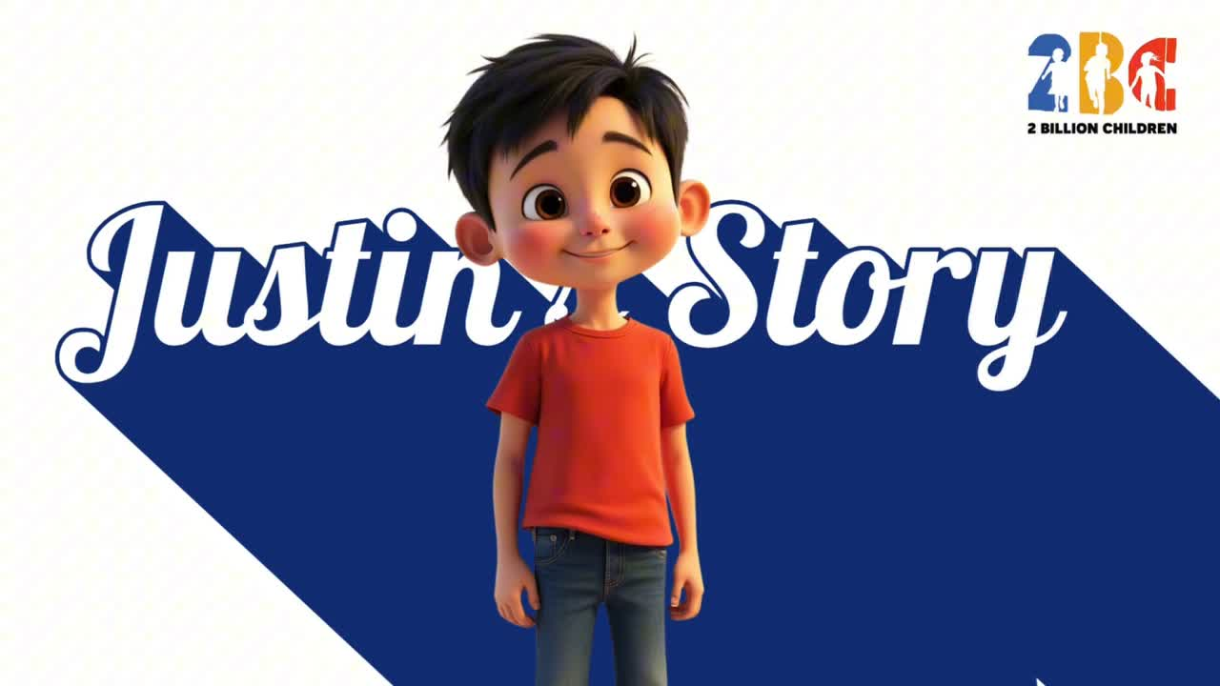

Slide 11


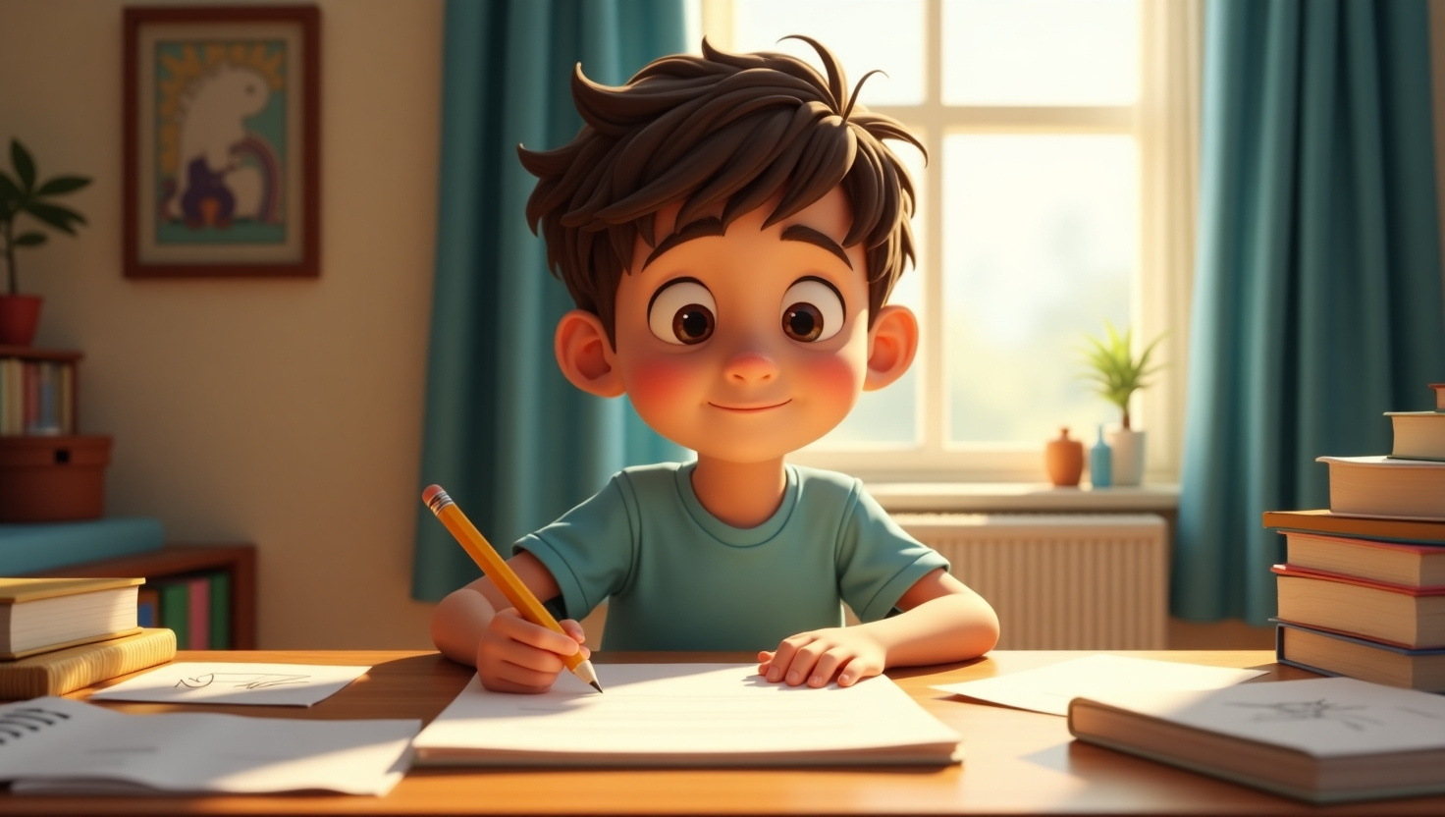

Justin is on the autism spectrum, and sometimes he finds it tricky to
talk with words. Yet God still speaks amazing truths to his heart!

Slide 12


“JUSTIN, YOU ARE PART OF MY BIG PLAN. I MADE YOU UNIQUE FOR A REASON.”
Those words filled Justin with hope. He wrote them down, and soon, he began sharing encouraging messages with friends and family.
Even though Justin has challenges, he’s discovered that God sees every part of us—our strengths and weaknesses—and still calls us to be champions on His team.

Slide 13

JESUS WANTS YOU
TO BE ON HIS TEAM
Just like Justin, you can trust that God has BIG plans for you, no matter what life looks like. That’s what it means to be on Jesus’s team!
He is the Greatest Champion ever and He wants us to be Champions, part of his Family—His Team.

Slide 14



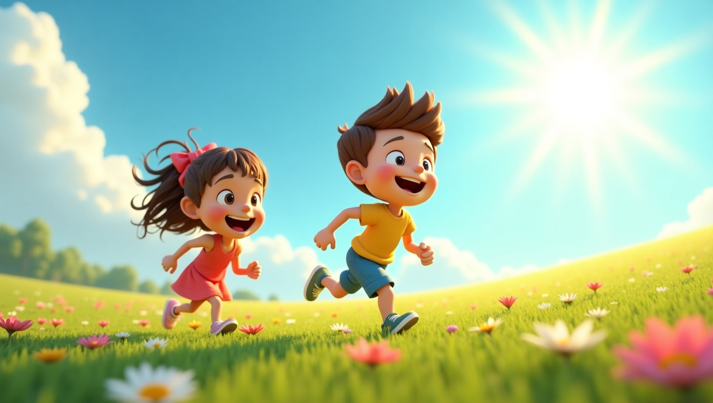
GOD, HOW YOU SEE ME AS A CHAMPION?
Take a moment to ask God this question.
You’ll feel a sense of peace, a word of encouragement, or just a warm feeling inside. That could be God reminding you that He has a special purpose for you!

Slide 15

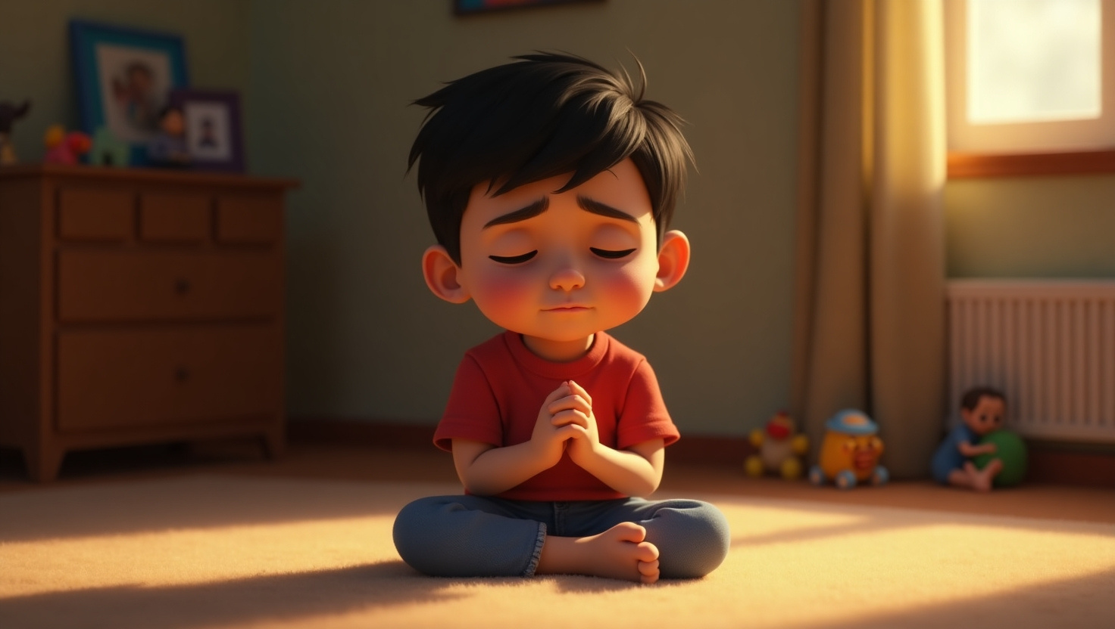



HOW CAN WE HEAR GOD’S VOICE?
Listening Prayer:
Take time to be still. Ask God a question, and listen quietly.

Slide 16
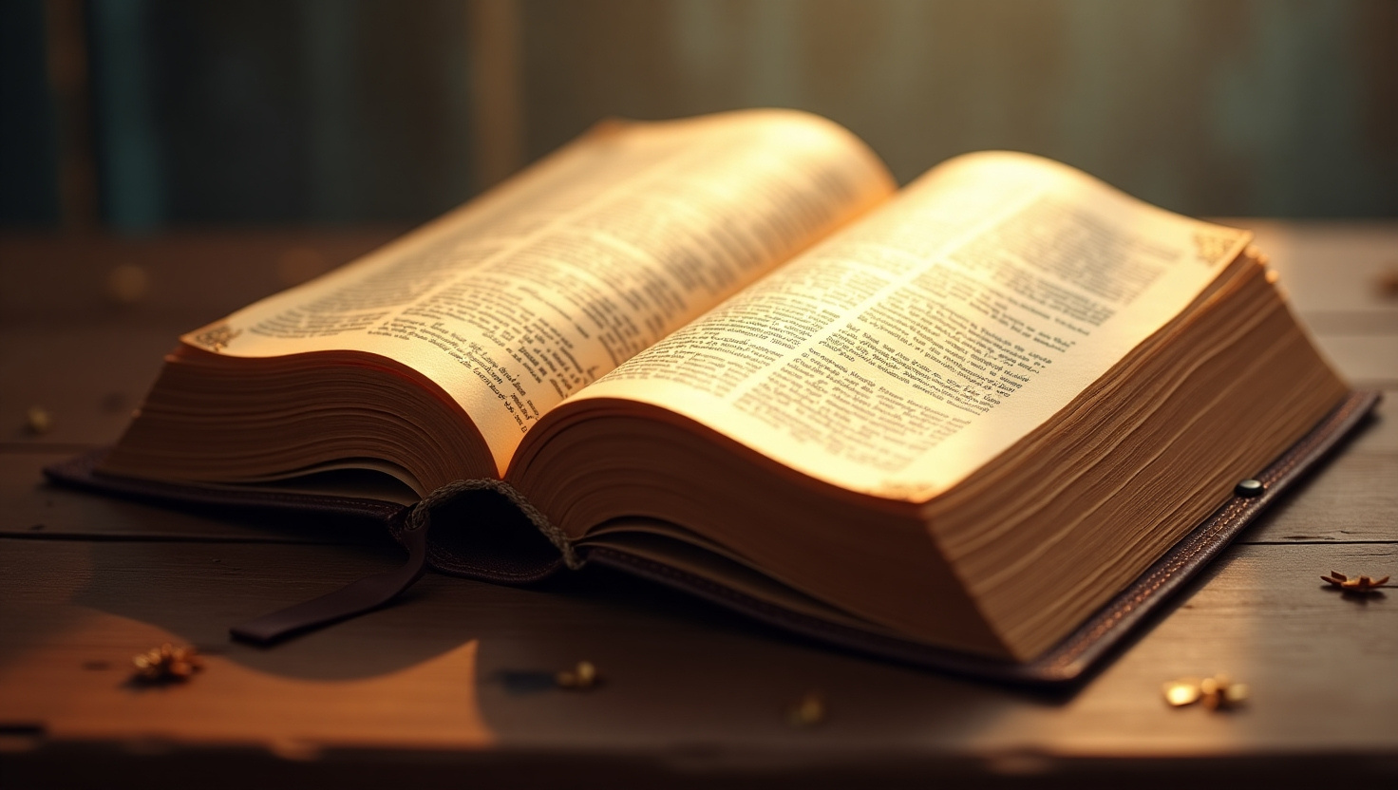

HOW CAN WE HEAR GOD’S VOICE?
Reading His Word:
The Bible is full of God’s promises, guidance, and love notes to you. God loves speaking to His children through His Word!

Slide 17
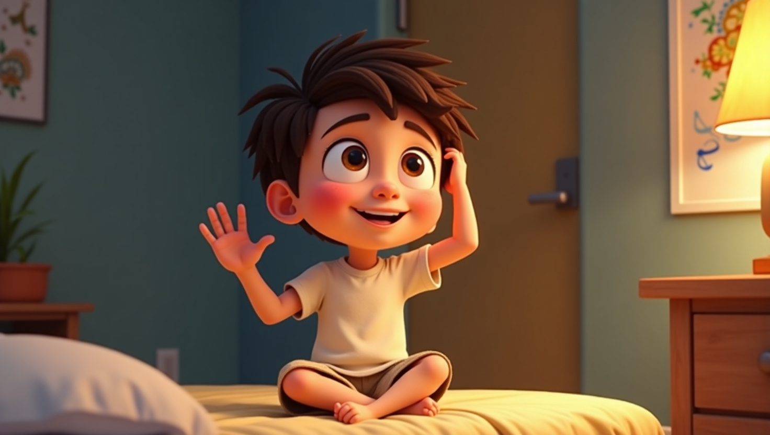

HOW CAN WE HEAR GOD’S VOICE?
Worship
Singing or listening to songs that honor God can help quiet our hearts and minds, so we can hear His voice.

Slide 18
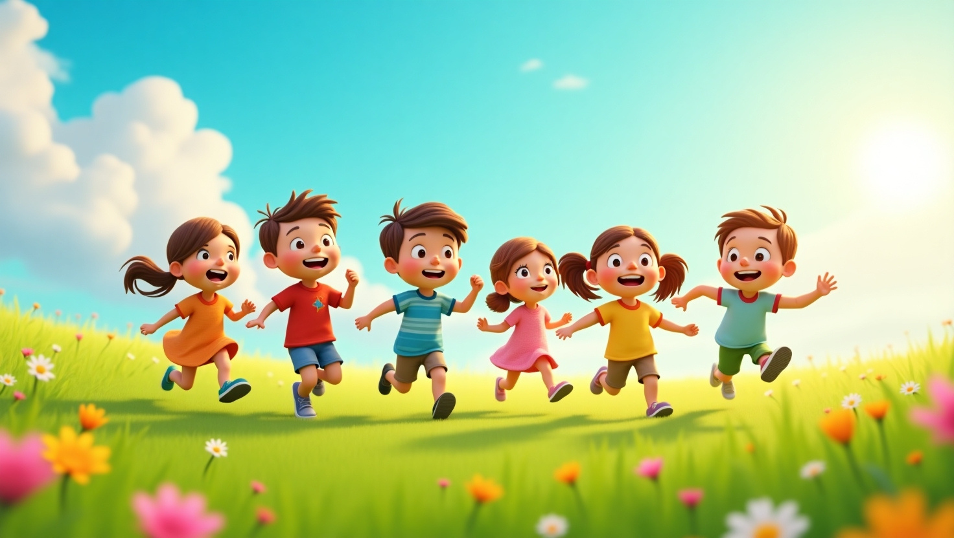


HOW CAN WE HEAR GOD’S VOICE?
Other People
Sometimes God speaks through a parent, teacher, or friend who loves Him and wants the best for you.
When you know Jesus is your Champion, you can trust that He’s always near, ready to speak into your life.

Slide 19
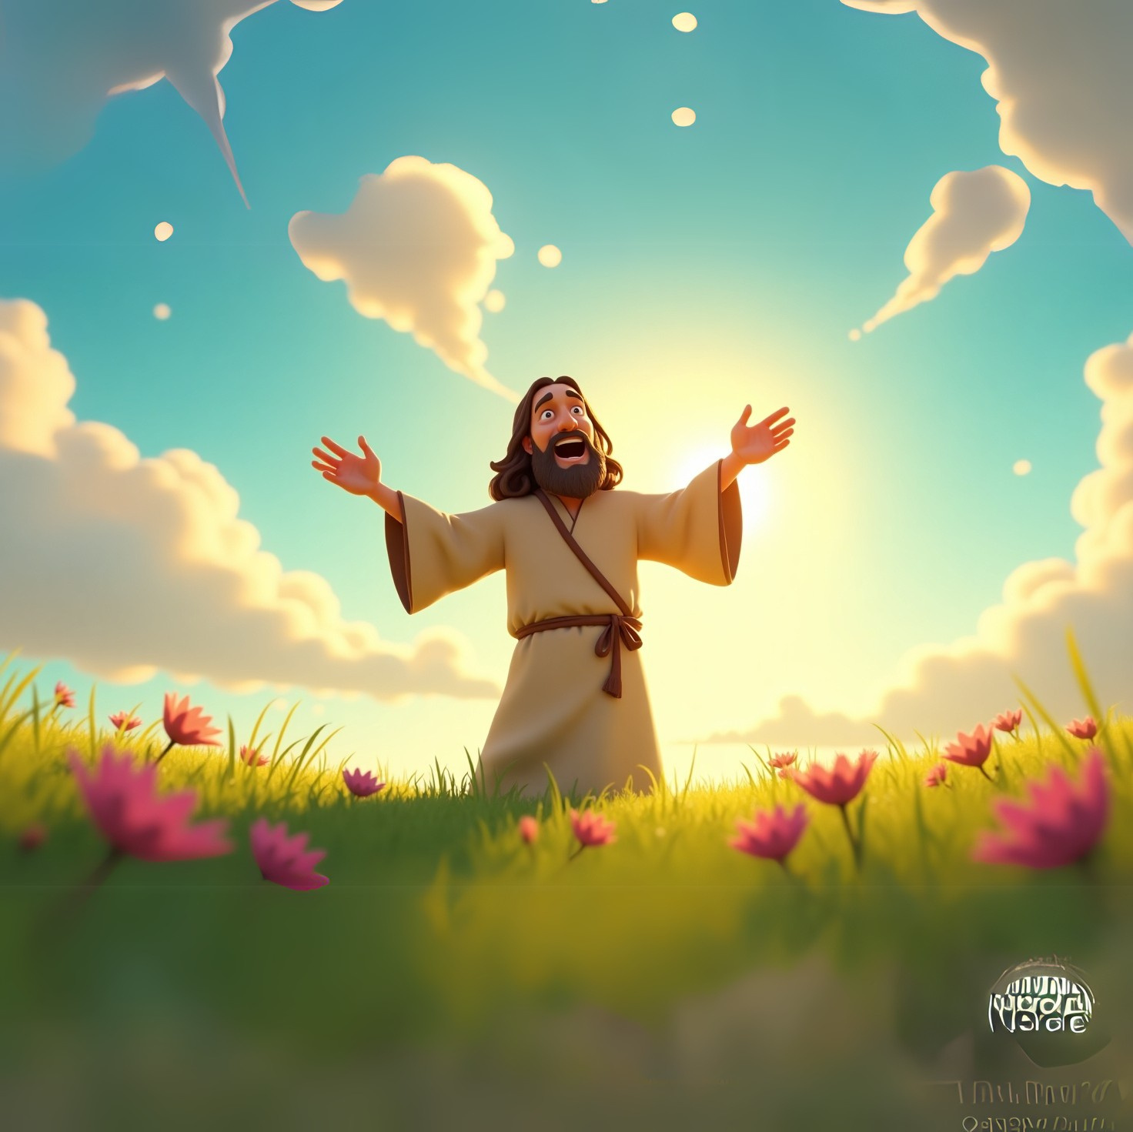

“JESUS HAS INVITED ME TO COME TO HIM BECAUSE THE KINGDOM OF HEAVEN BELONGS TO CHILDREN LIKE ME. HE HAS TOLD ME TO LISTEN TO HIS VOICE AND TO FOLLOW HIM.”

Slide 20

Stay tuned for the next module :
Super Special in God’s Eyes!

Slide 21



