Slide 1













MODULE 3
SUPER SPECIAL
IN
GOD’S EYES

Slide 2


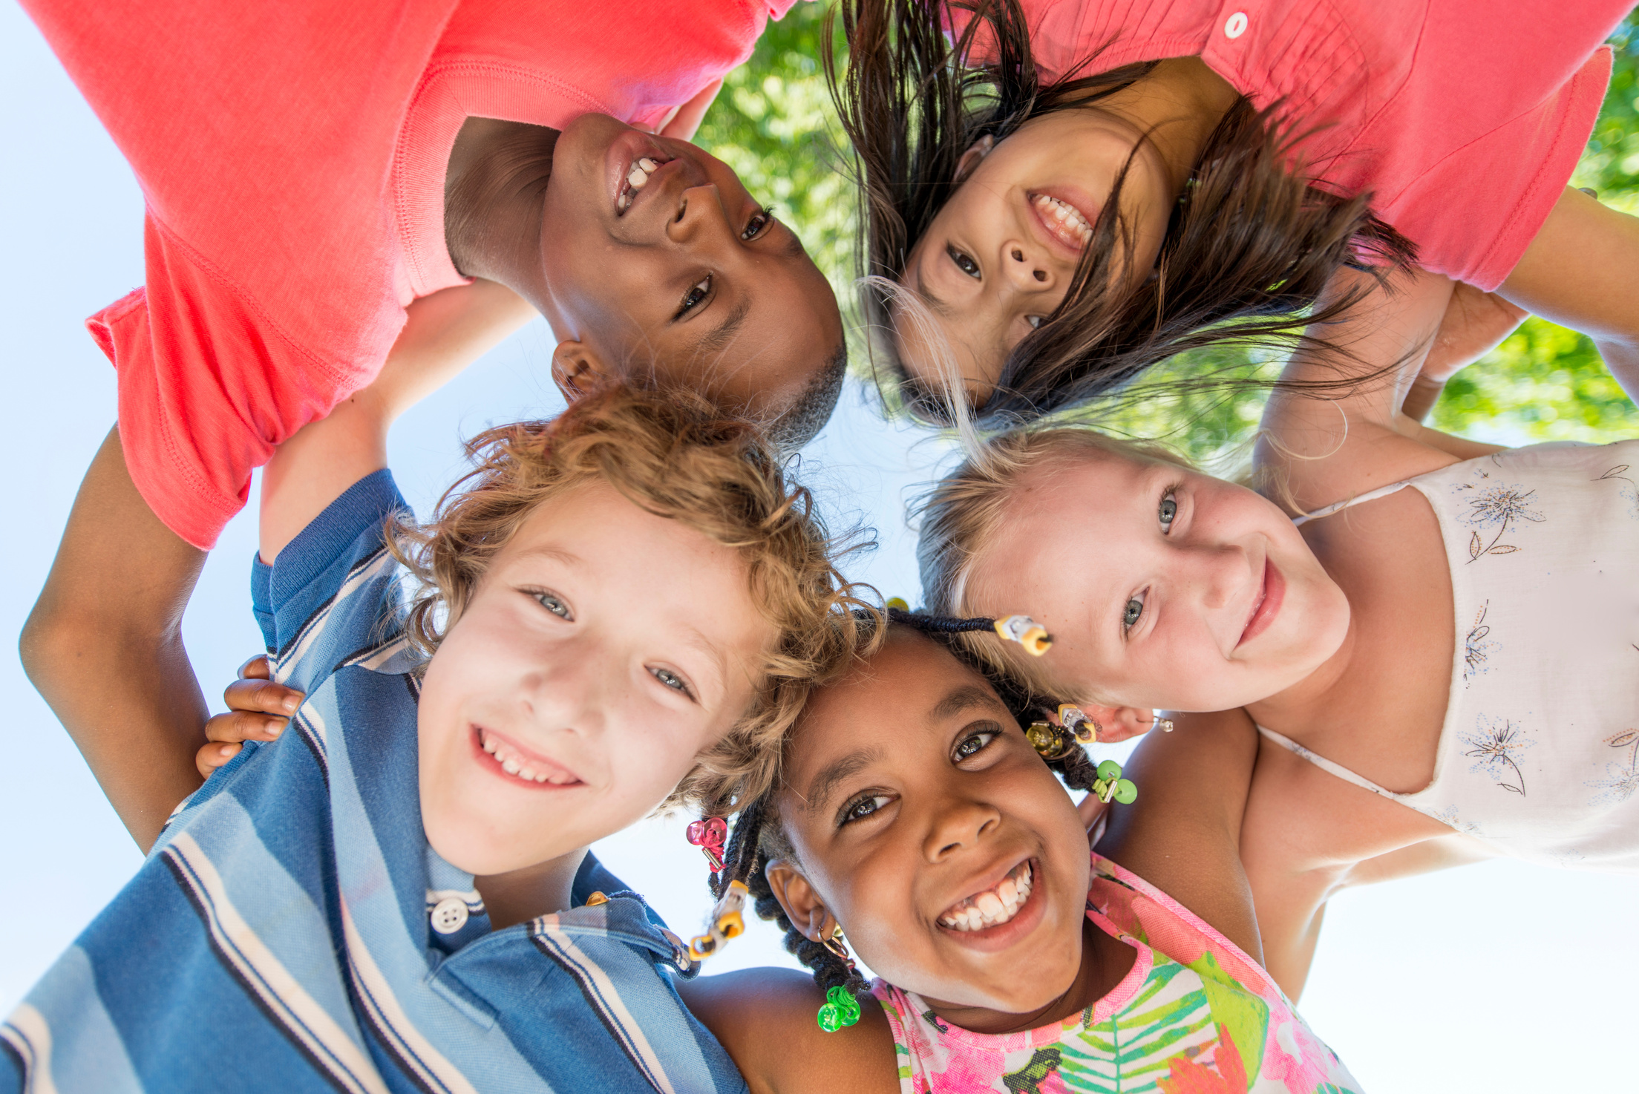


YOU ARE SUPER SPECIAL IN GOD’S EYES!
You are really amazing !
Sometimes we think we’re too small or not special enough. But here’s the truth:
“GOD, YOU CREATED EVERY PART OF ME. YOU KNEW ME BEFORE I WAS EVEN BORN. I PRAISE YOU BECAUSE I AM WONDERFULLY MADE.”

Slide 3
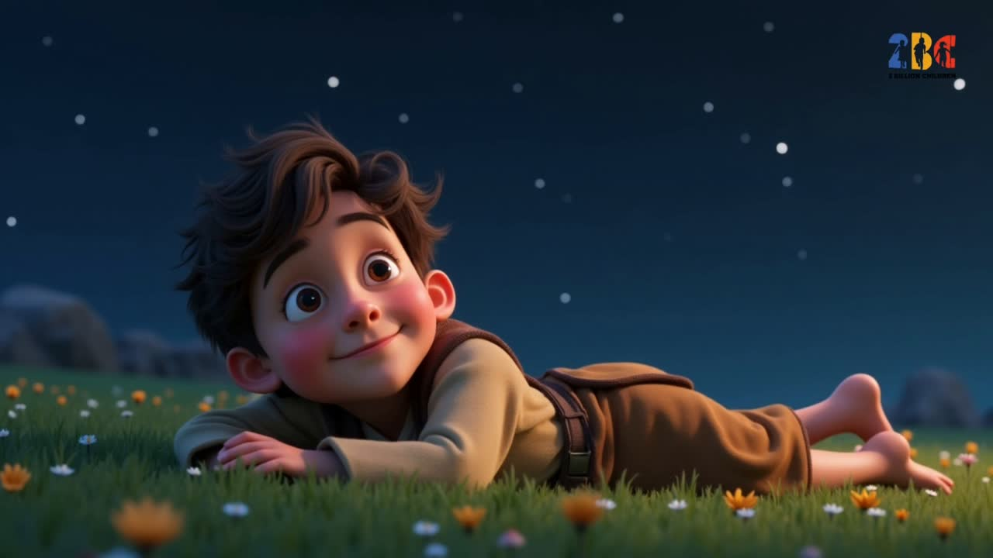

Slide 4

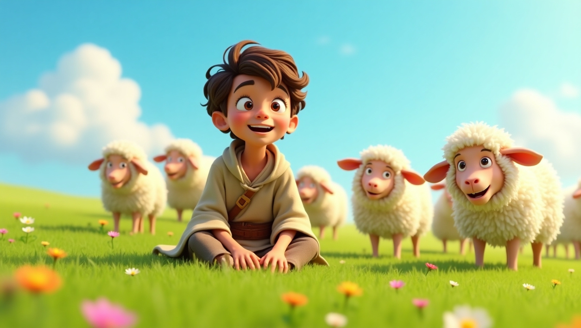



DAVID WROTE A SONG TO GOD
“God, You created every part of me. You knew me before I was even born. I praise You because I am wonderfully made.”
David realized that each detail of his life—his eyes, his hands, his heart—was designed by God. Even before anyone else noticed him, God saw David’s potential. And guess what? David learned that God wasn’t just powerful—He was personal, loving, and saw David as His favorite, too.

Slide 5
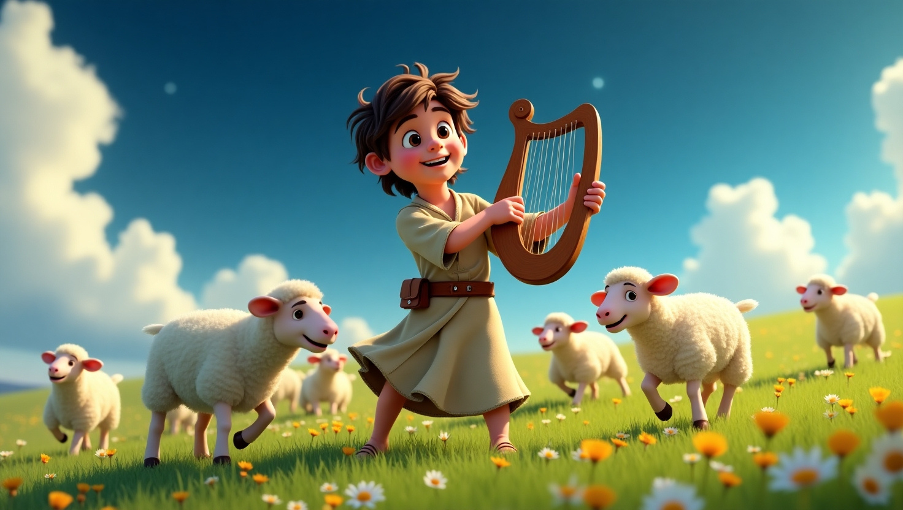
“God, You created every part of me. You knew me before I was even born. I praise You because I am wonderfully made.”

Slide 6

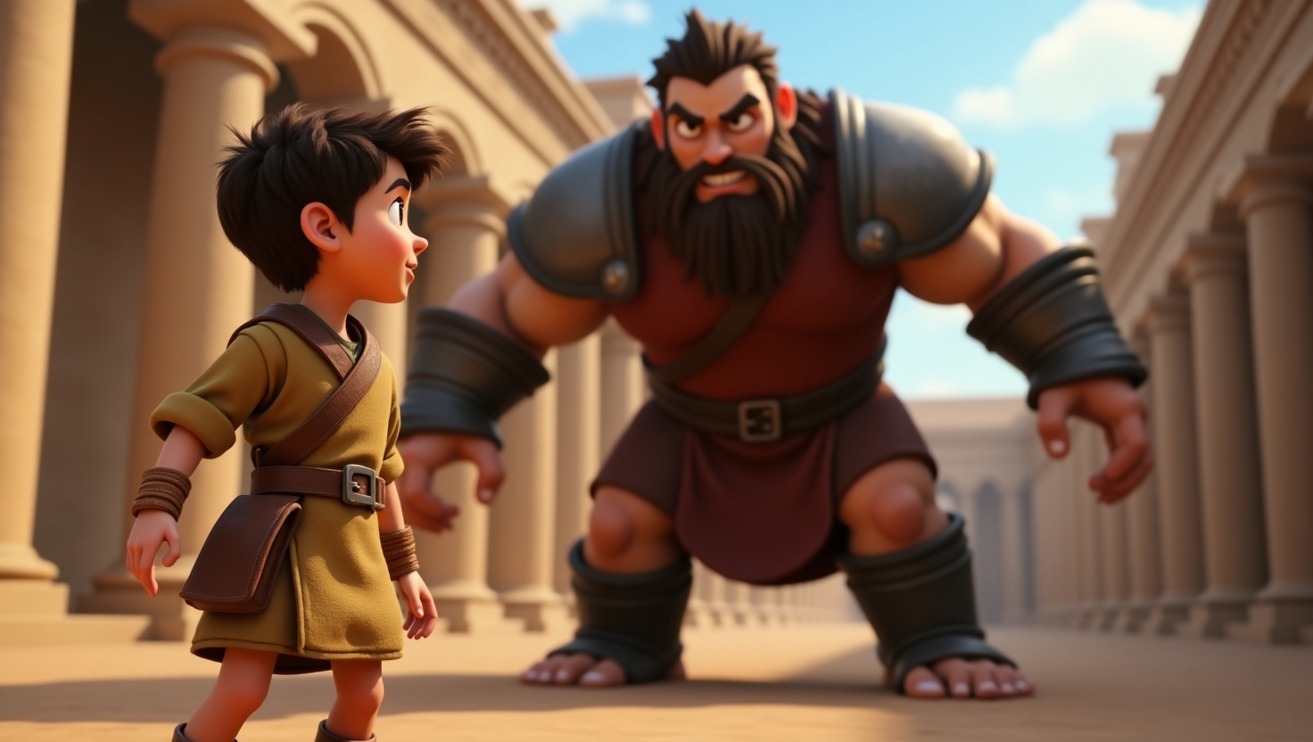


WHEN DAVID FACED SCARY CHALLENGES
he remembered he was created by a powerful, caring God.
That truth made him brave!

Slide 7

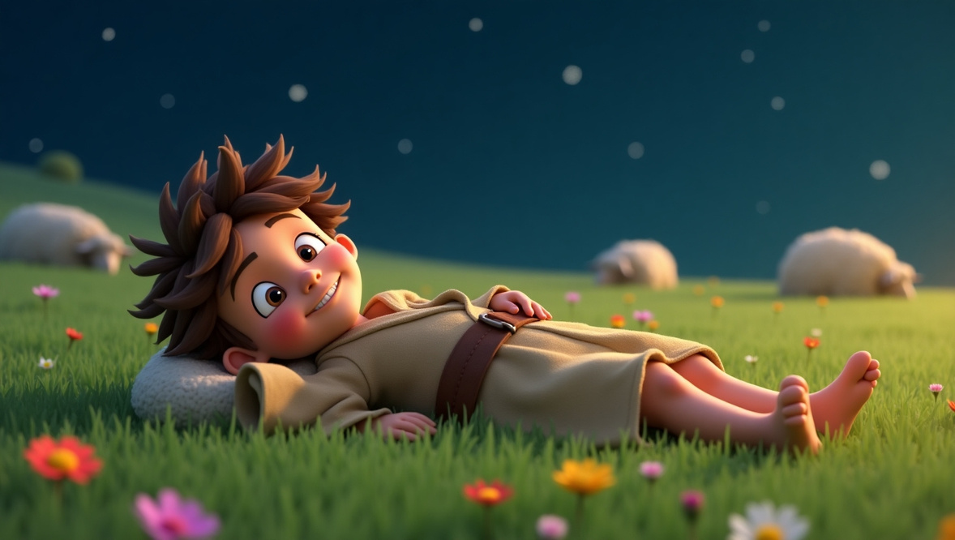


“How does it feel to know God made you special?”
Close your eyes for a moment. Picture yourself outside at night, gazing up at the stars like David did. Feel the wonder of how big God is.
Now think about this: that same God who made the entire universe
carefully made you, too.

Slide 8


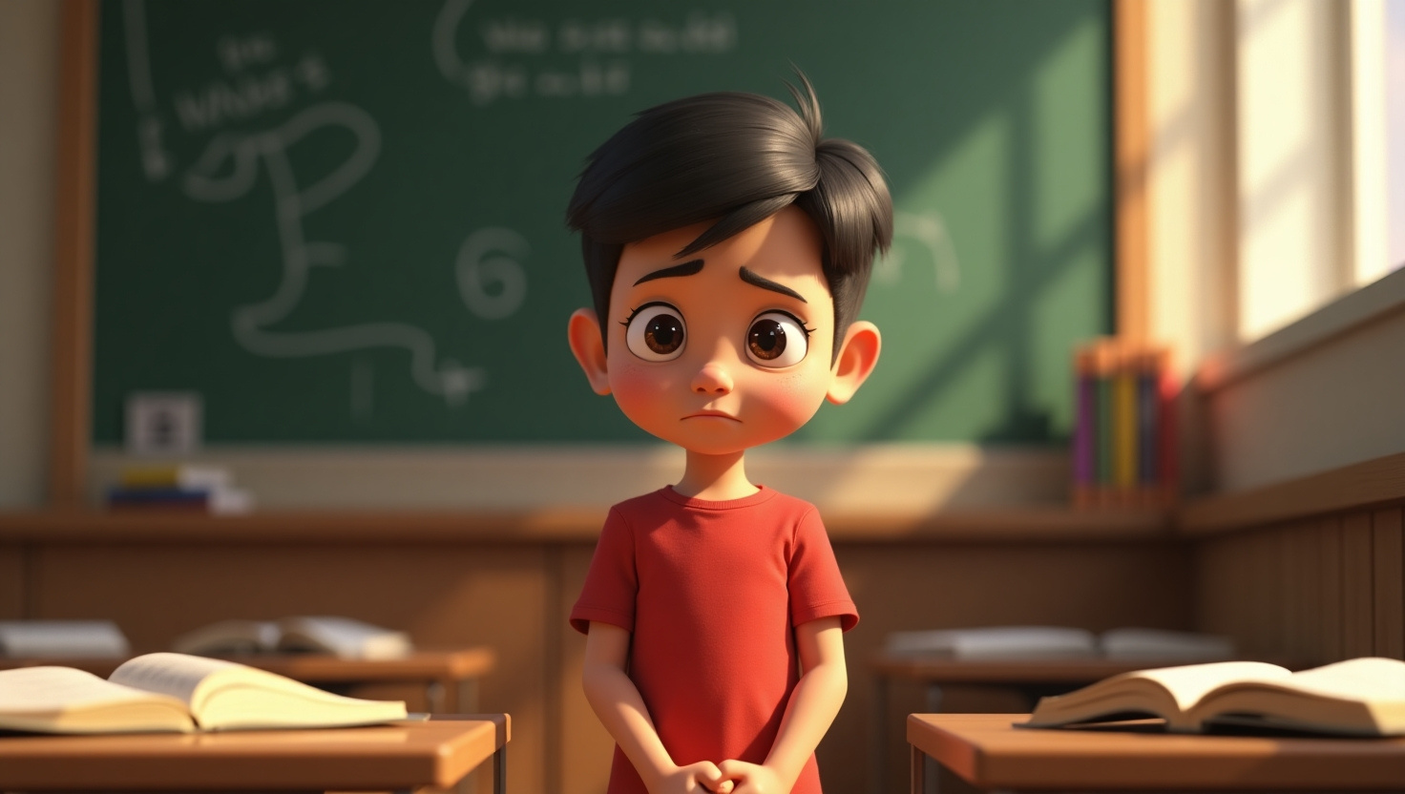

JUSTIN”S STORY
Remember Justin? He sometimes finds it hard to communicate with words, but he’s discovered a unique way to share God’s love—through his writing!

Slide 9
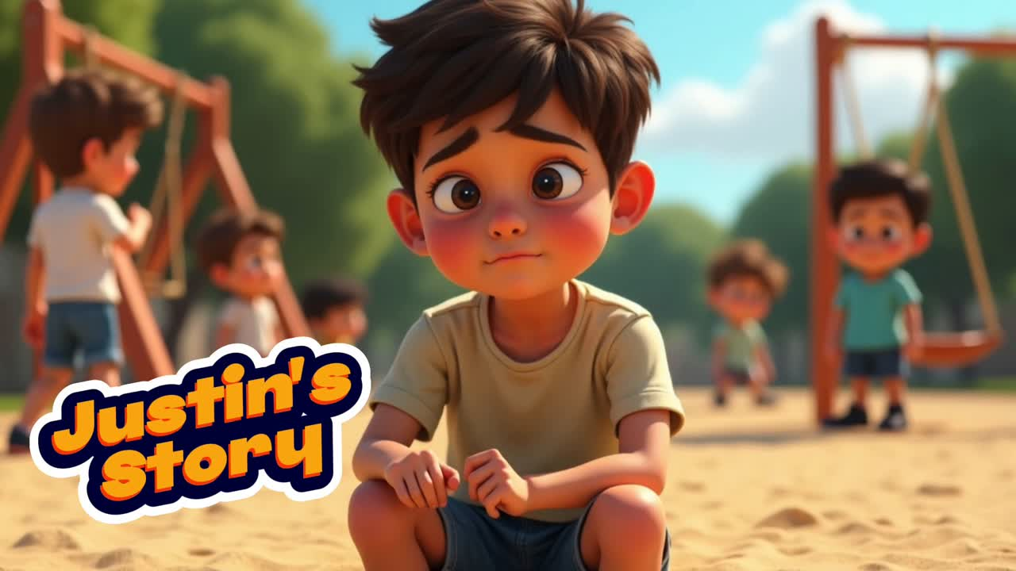

Slide 10

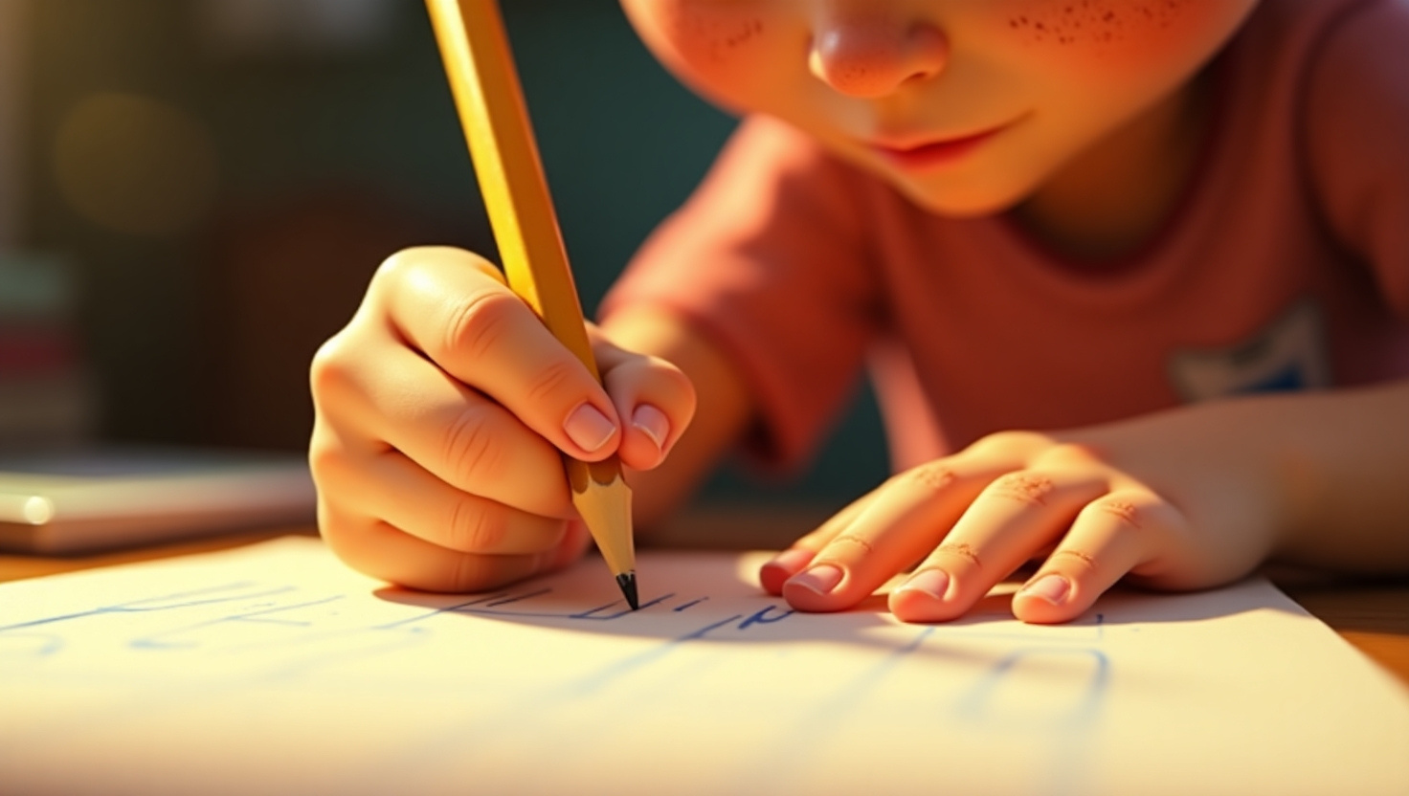
"YOU MIGHT FEEL DIFFERENT, BUT GOD MADE YOU JUST THE WAY HE INTENDED!"
Even when Justin faces challenges, he remembers that God has a purpose for everything about him. His writing encourages people to see themselves as God’s favorites, too. By sharing his art, Justin is telling the world, “I am God’s favorite—He loves me the best!”

Slide 11

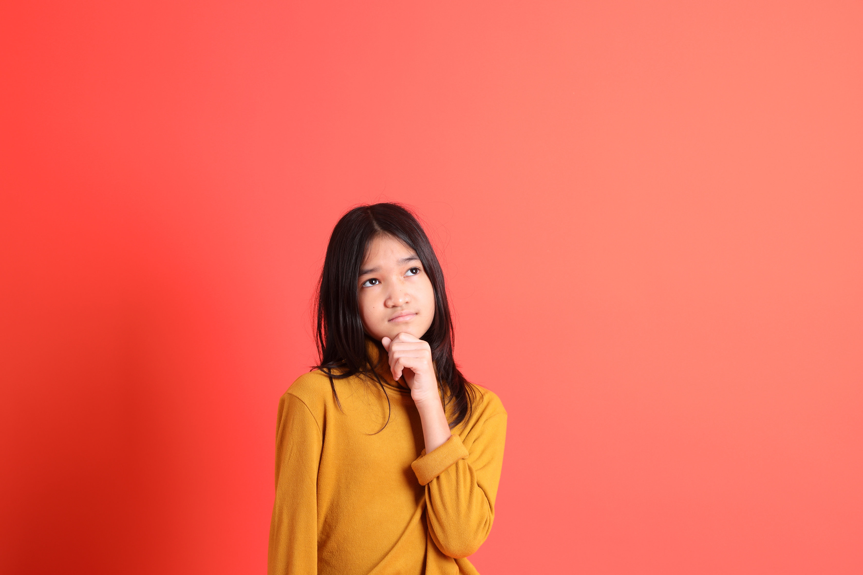

“GOD, WHAT’S ONE SPECIAL THING YOU SEE IN ME?”
“HOW CAN I USE THAT TO SHOW YOUR LOVE TO OTHERS?”

Slide 12
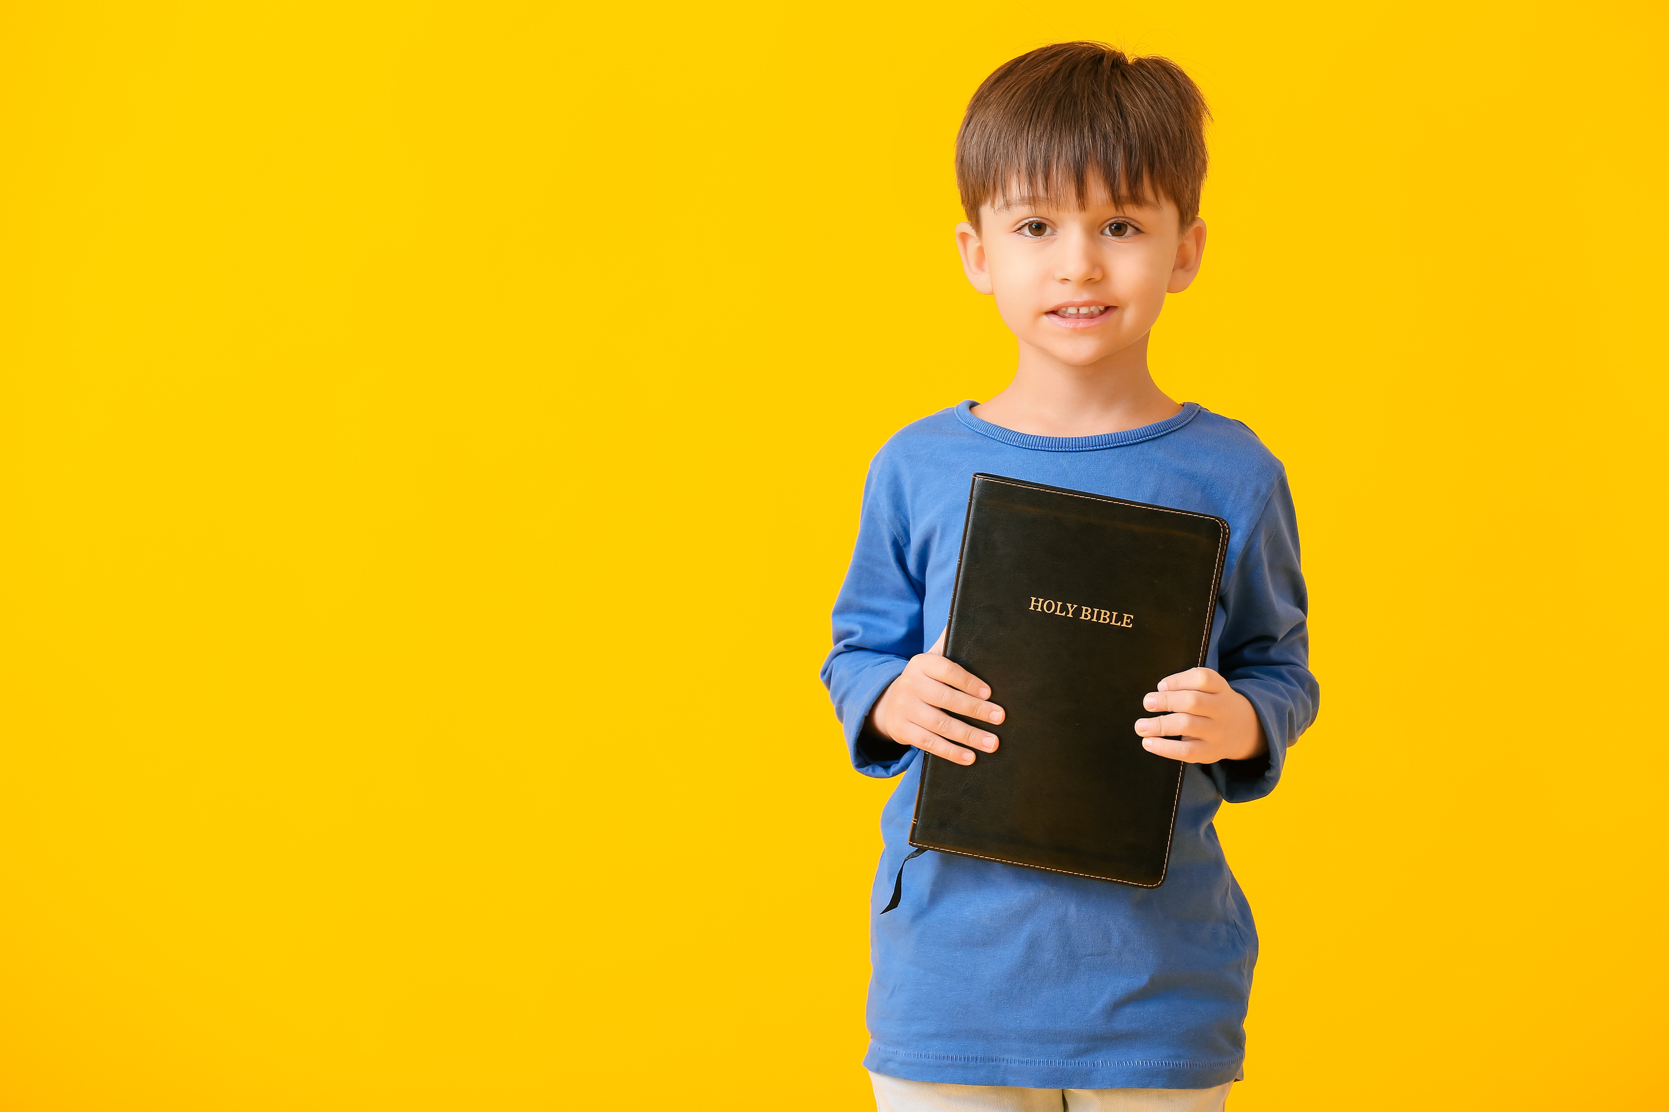



HOW DO WE REALLY BELIEVE WE’RE SUPER SPECIAL IN GOD’S EYES?
Remember God’s Word
Reading verses like Psalm 139 reminds us that God took great care in making us.

Slide 13

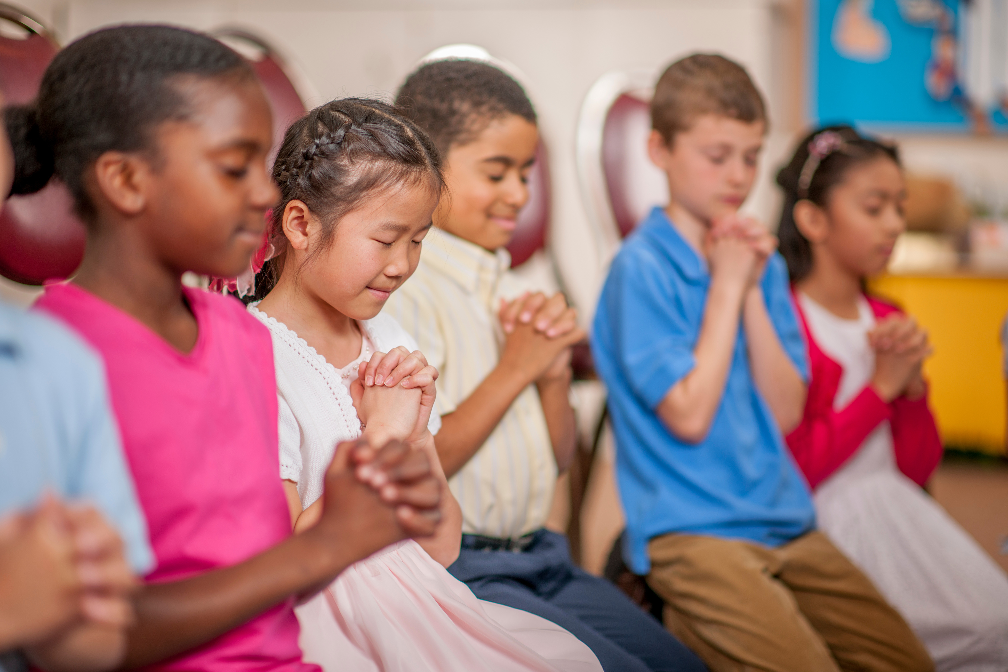


HOW DO WE REALLY BELIEVE WE’RE SUPER SPECIAL IN GOD’S EYES?
Listening Prayer:
Talk to God like a friend. Ask Him to show you more about who you are.

Slide 14
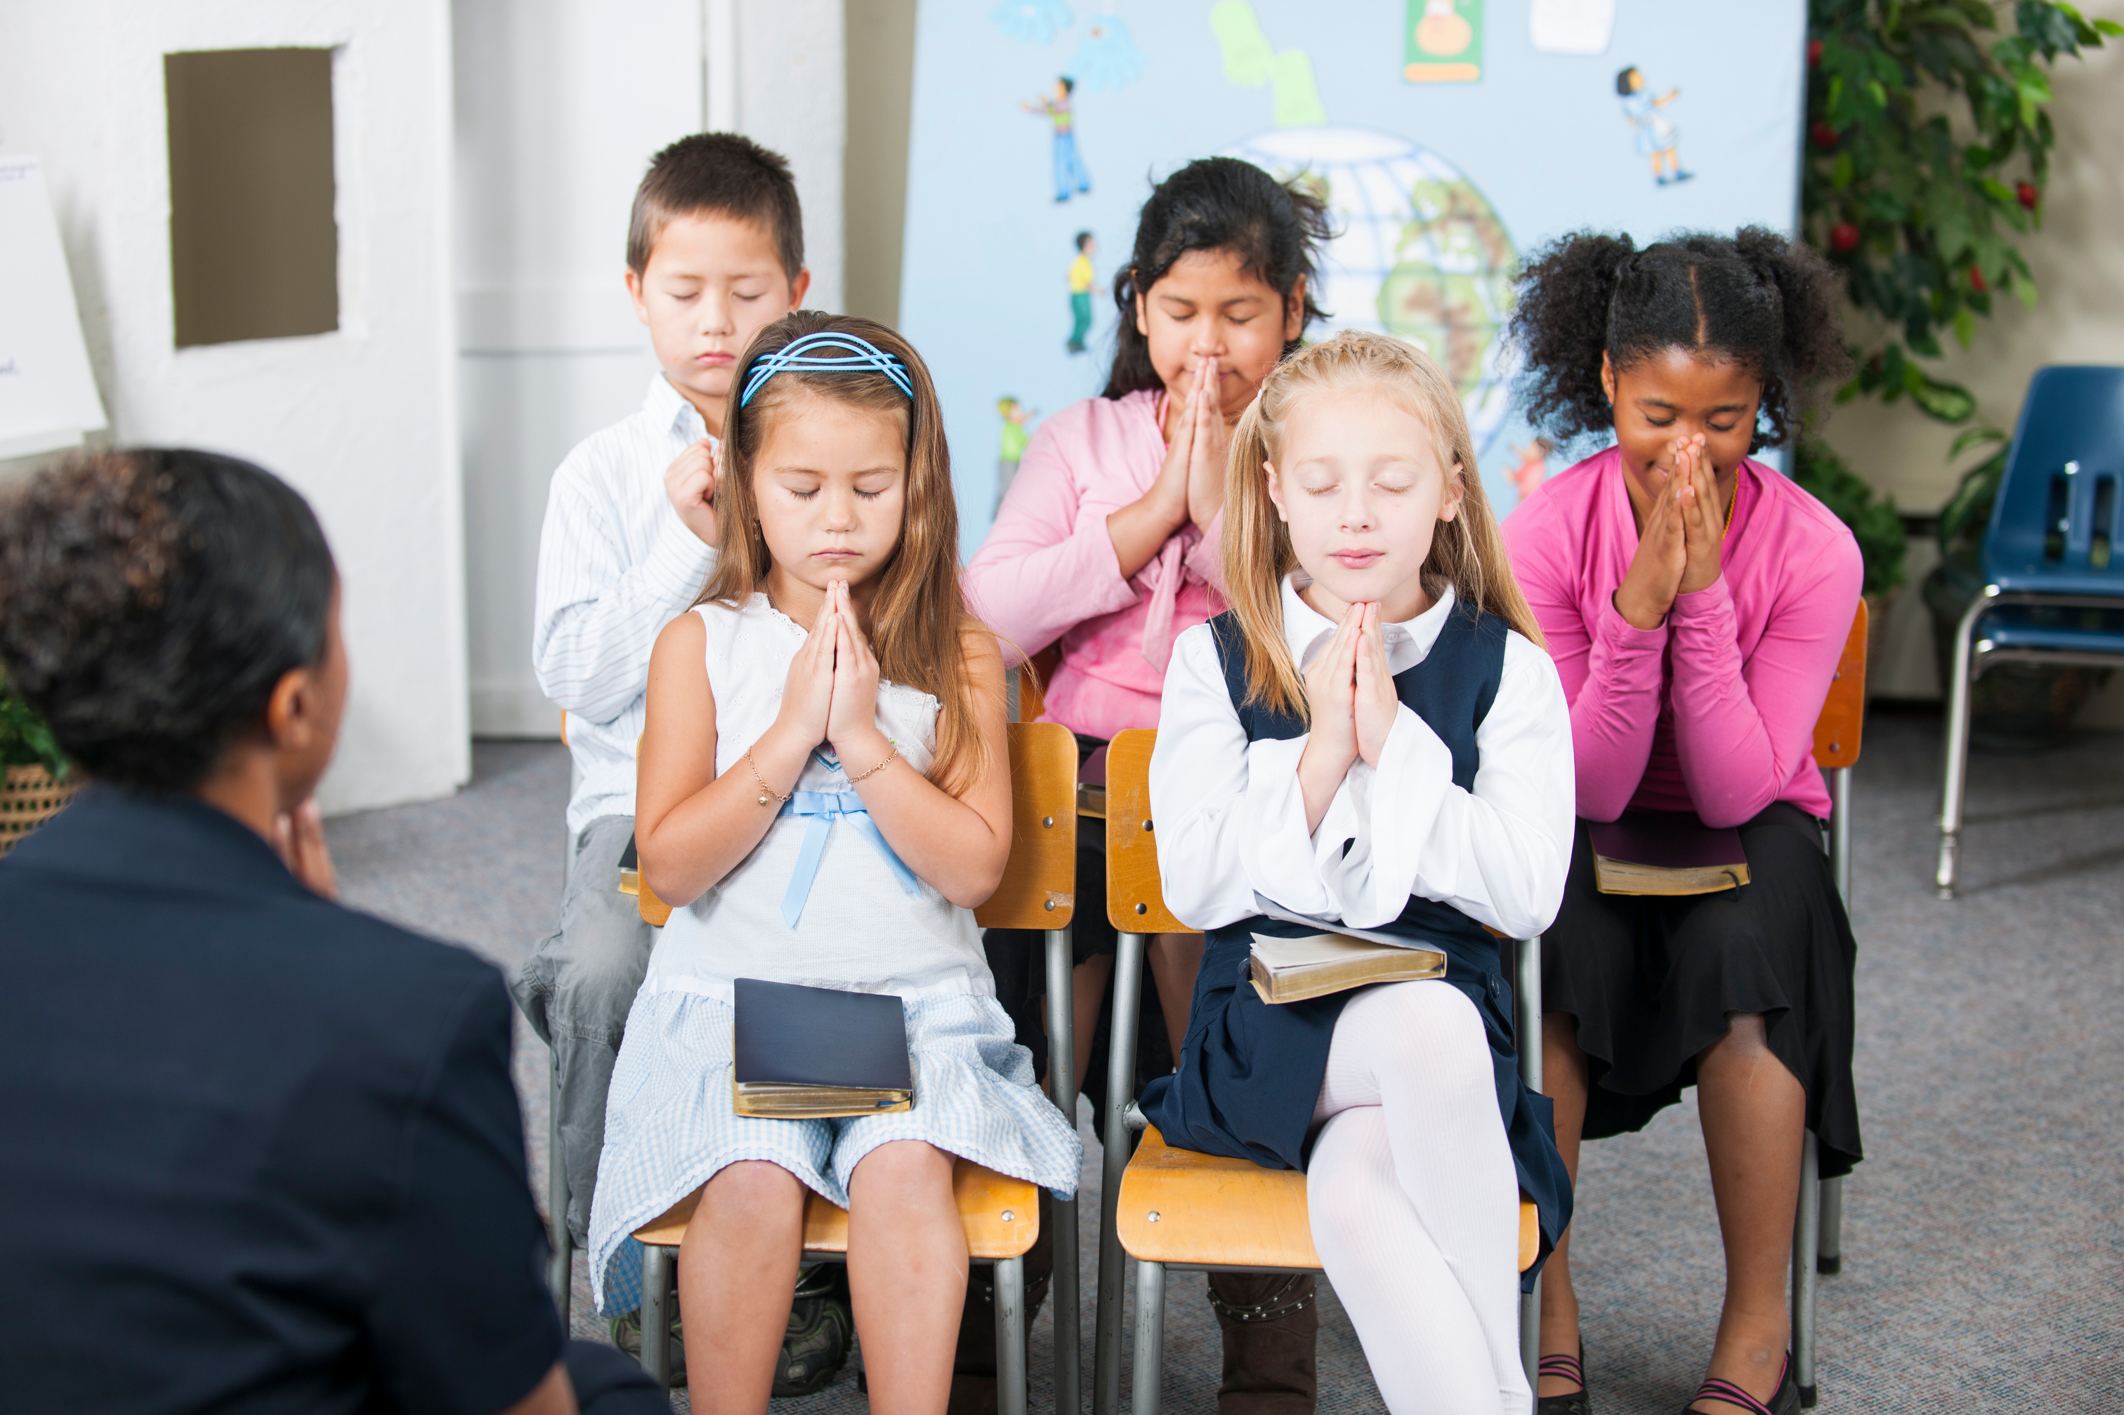

HOW DO WE REALLY BELIEVE WE’RE SUPER SPECIAL IN GOD’S EYES?
Worship
When we sing or pray, we remind ourselves of God’s goodness, and open our hearts to hearing His voice.

Slide 15
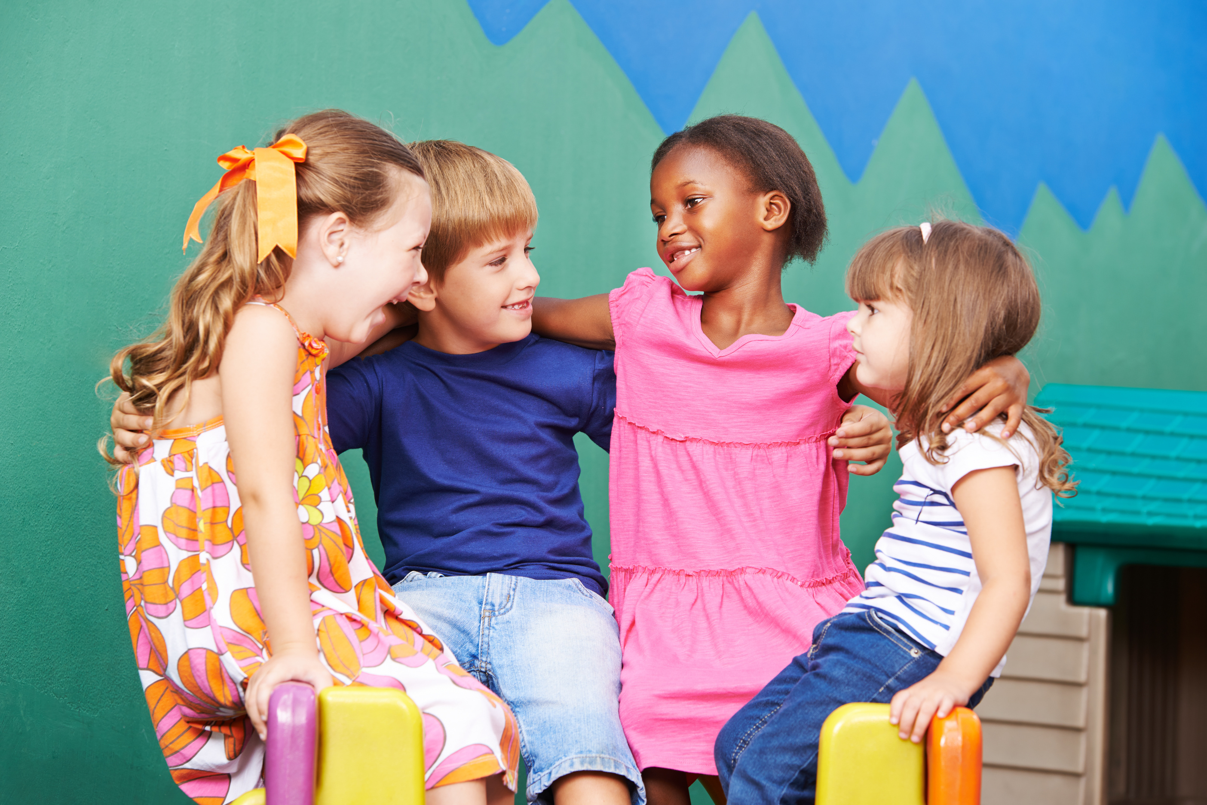

HOW DO WE REALLY BELIEVE WE’RE SUPER SPECIAL IN GOD’S EYES?
Encourage One Another:
Sometimes a parent, friend, or teacher can see something special in us that we might miss. Listen to encouraging words—they might be from God!

Slide 16
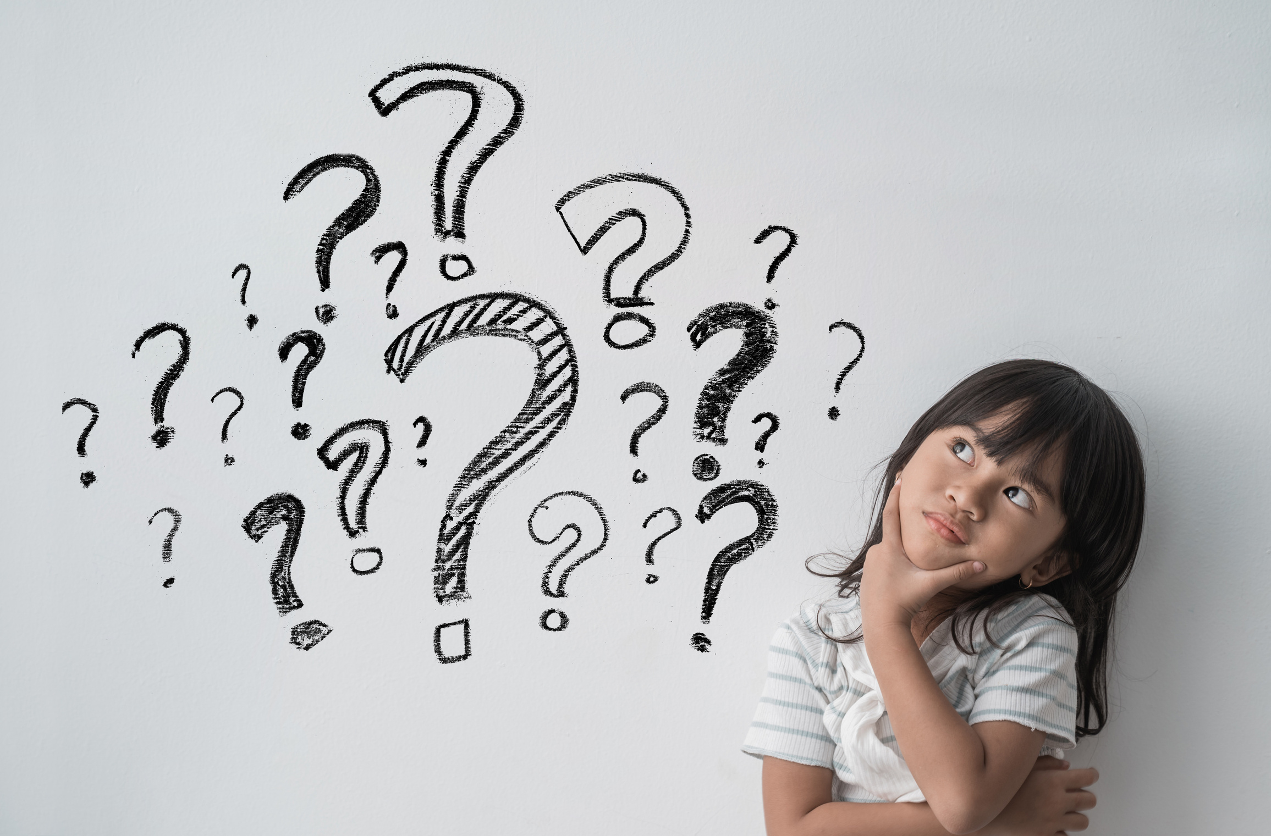
NOW IT’S TIME FOR A CHALLENGE
1. Ask God 2 Questions
  “God, what’s one way You want to use my unique gift`s to bless others?”
  “God, how can I show someone else they are super special, too?”

Slide 17
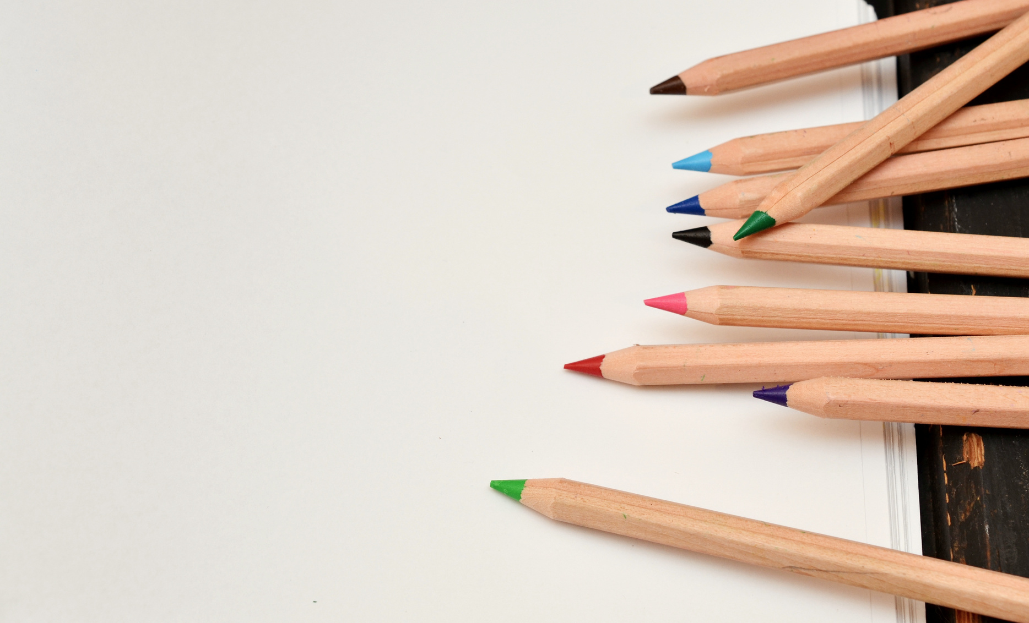
NOW IT’S TIME FOR A CHALLENGE
2. Write or Draw Your Response
  Use a worksheet or a blank page. Write or draw whatever you sense from God—maybe it’s a picture, a word, or a feeling of peace.

Slide 18
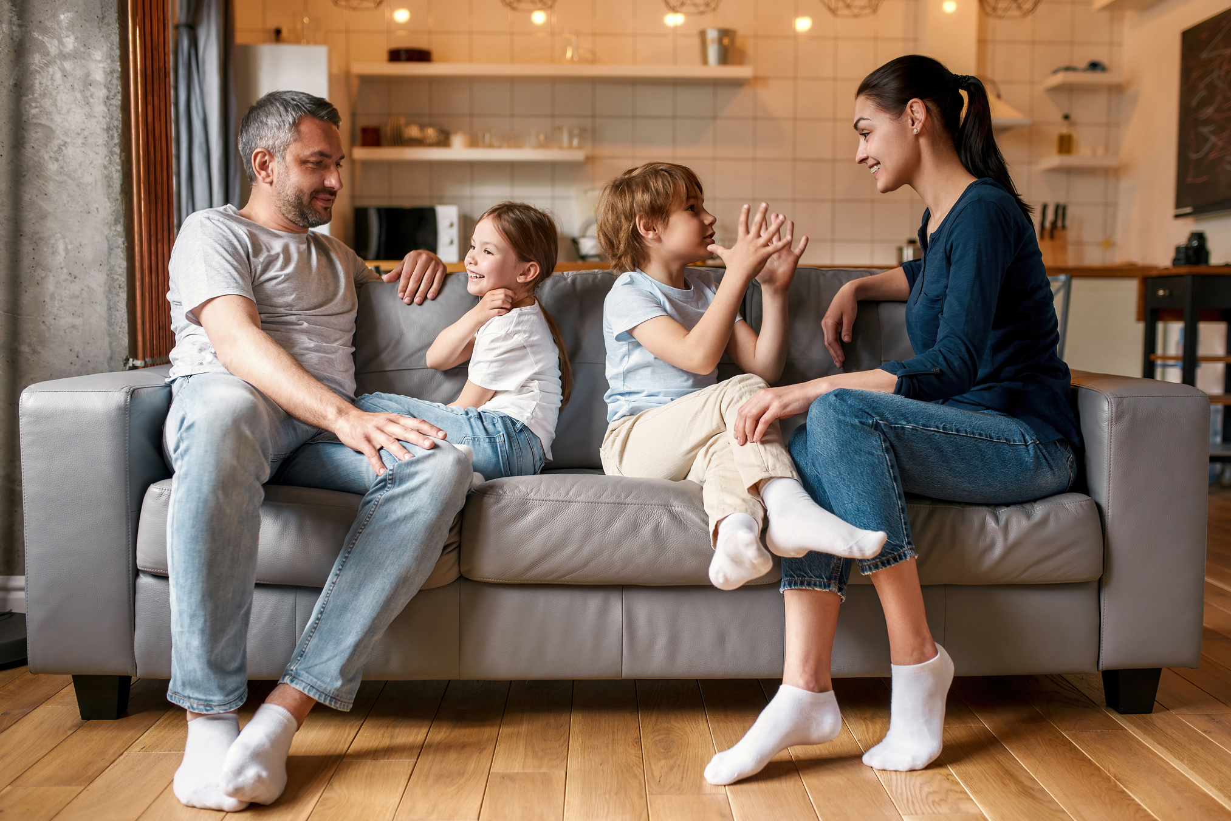
NOW IT’S TIME FOR A CHALLENGE
3. Share What God Showed You
  Tell a friend or family member how God spoke to you.

Slide 19



COMING UP NEXT :
YOUR NEXT LESSON!
LET’S TALK
TO GOD!

