Slide 1










MODULE 6
SHARE
GOD’S LOVE!

Slide 2





HAVE YOU EVER FELT A LITTLE SPARK IN YOUR HEART TO DO SOMETHING KIND FOR SOMEONE?
That could be the Holy Spirit nudging you to share God’s love!
In this final module, we’ll discover how you can show God’s love to the people around you—whether they’re close friends or someone you’ve never met.

Slide 3


Slide 4

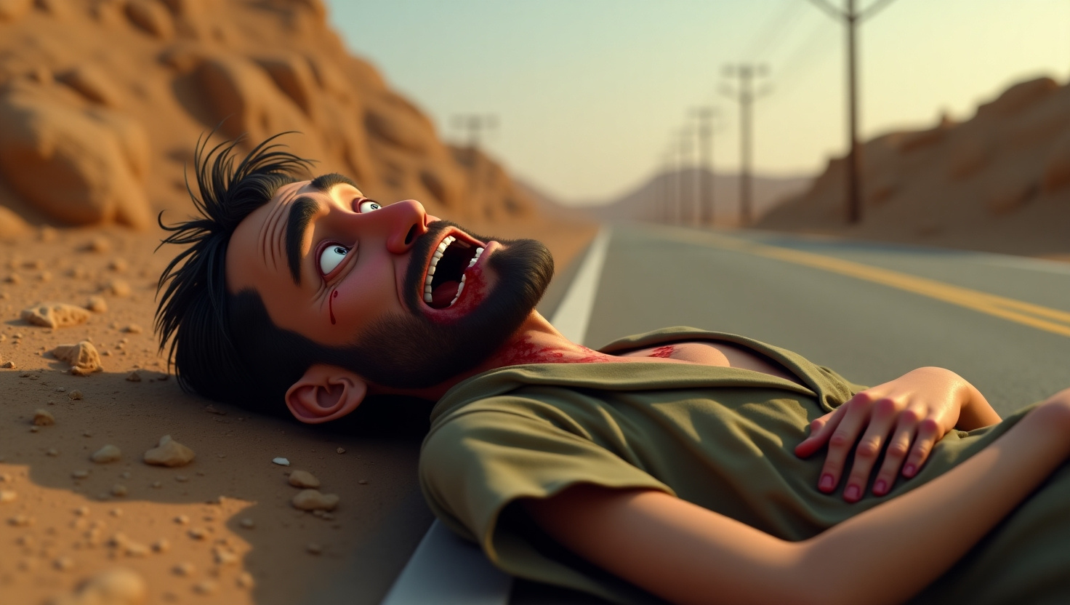


THE GOOD SAMARITAN
Jesus once told a story about a traveler who was robbed, hurt, and let alone on the road.
A few people passed by and didn’t stop to help.
But then someone came along—someone people least expected—a Samaritan.

Slide 5



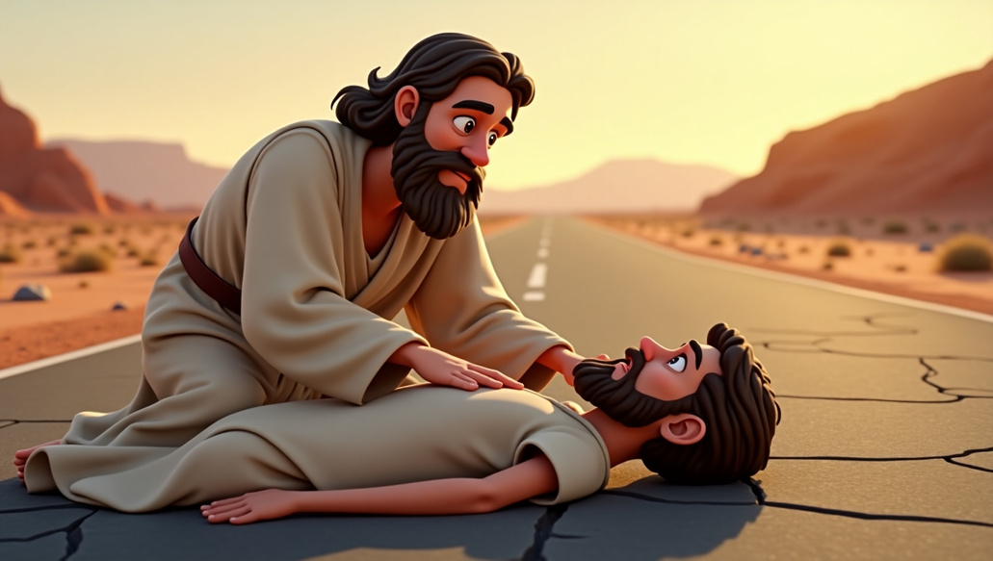
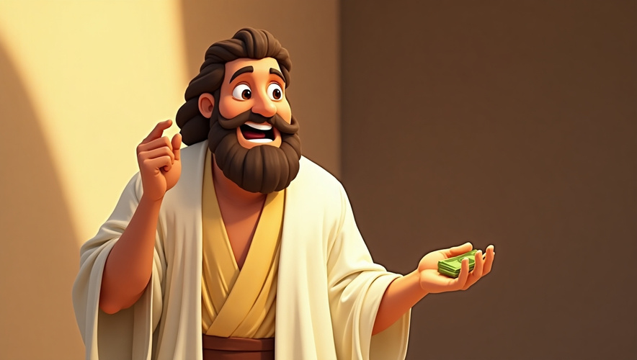



He paid for his care until the traveler was well again
He bandaged his wounds and took him to a safe place
He stopped to see if the traveler was okay.

Slide 6



“WHO COULD YOU HELP IF YOU SAW THEM IN NEED?”
Ask God, “Is there someone around me who needs help, comfort, or a friend?”
Listen for a moment—perhaps a name or face comes to mind. Keep that in your heart as we move forward

Slide 7






JUSTIN’S STORY
You’ve heard about Justin—he loves writing notes of encouragement to people.
Over time, his letters have brought hope to neighbors, classmates, and even strangers.
Some people have felt lonely, others worried or sad, but Justin’s kind words reminded them they’re loved by God and never alone.

Slide 8
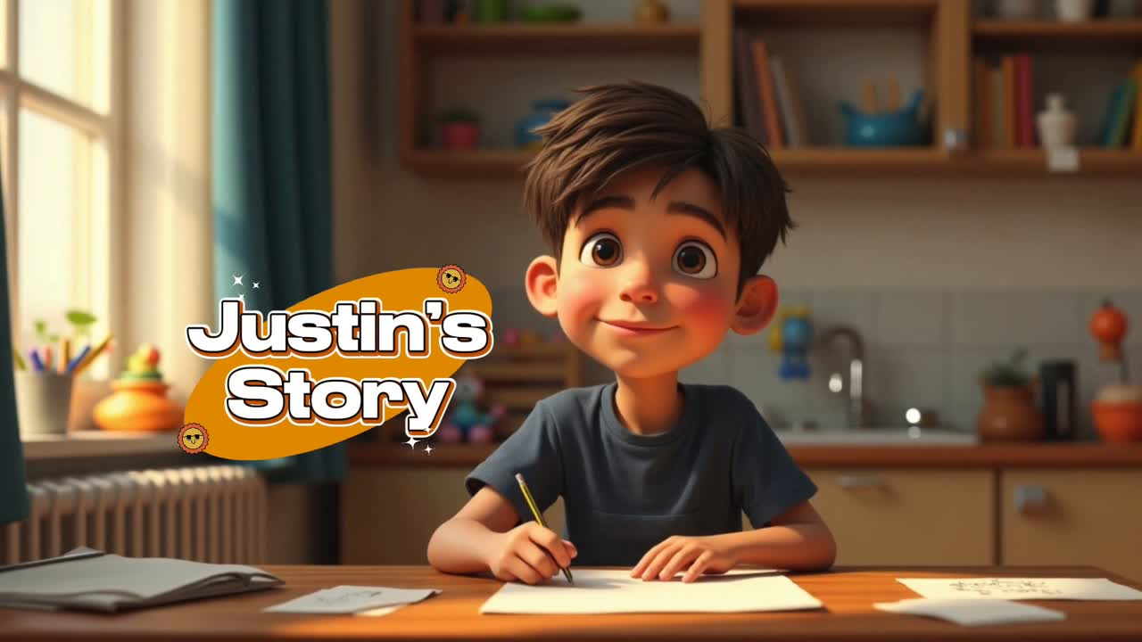

Slide 9

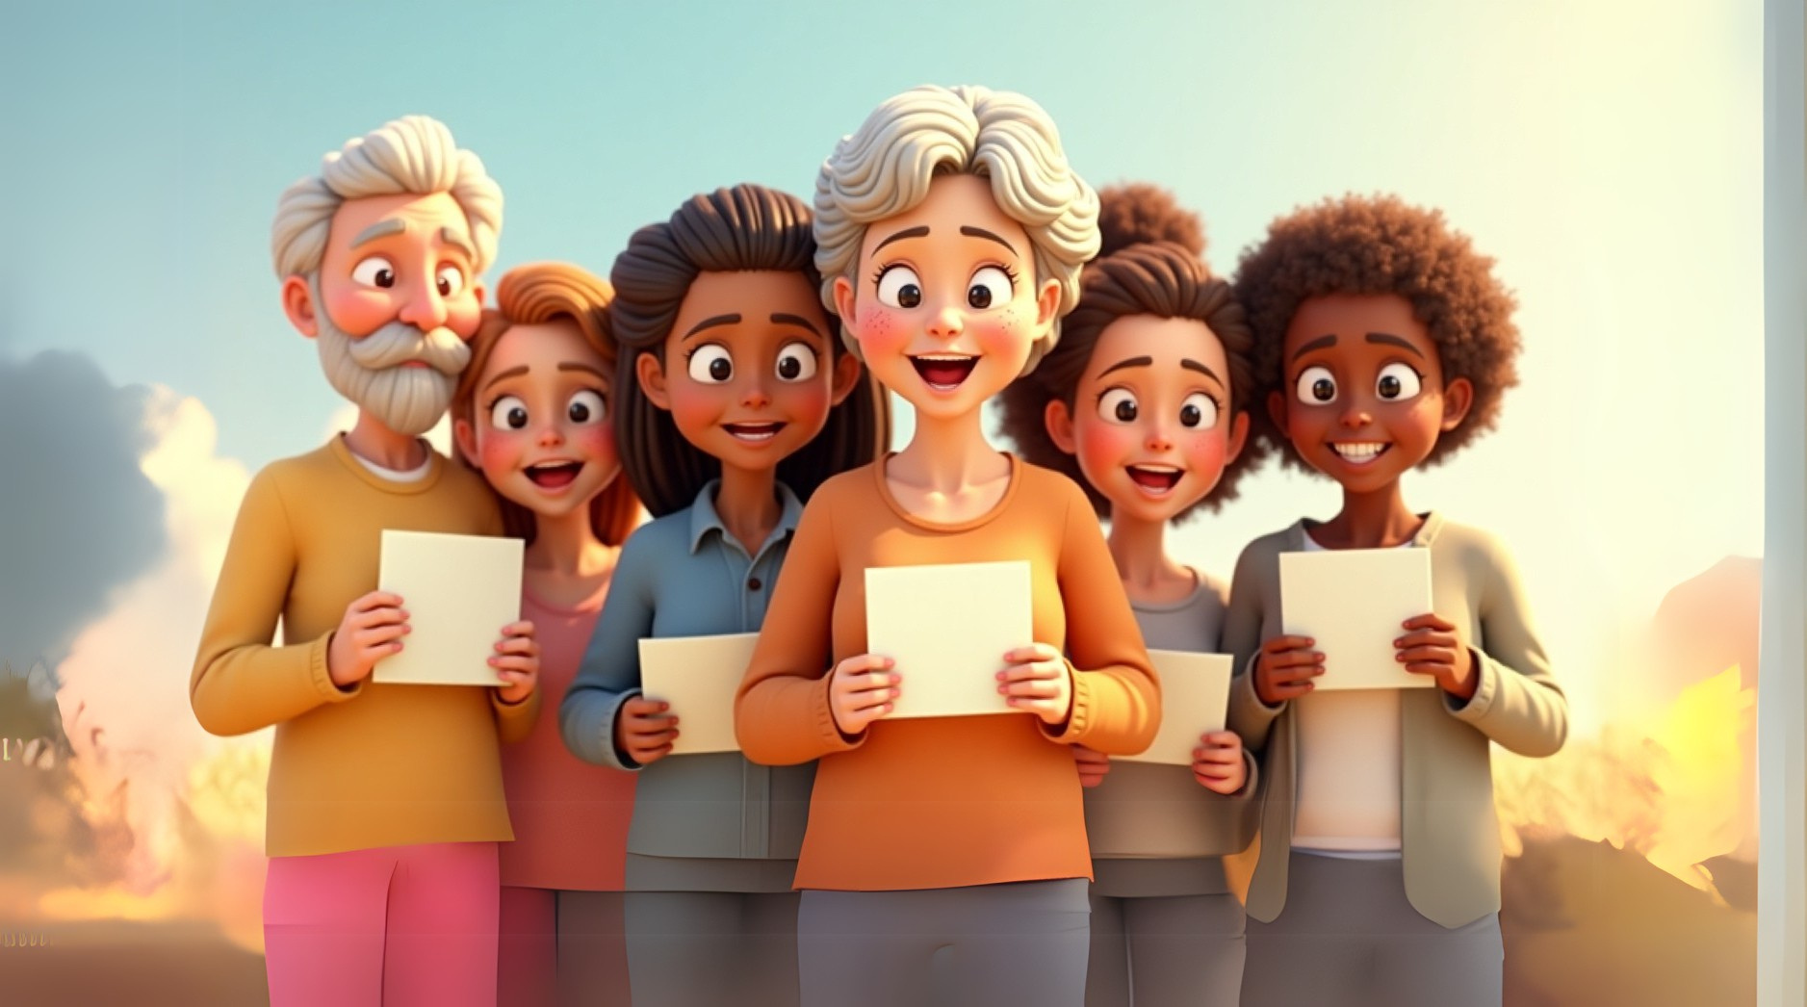




Because Justin keeps sharing God’s love, he has seen people smile, cry tears of joy, or even decide to know more about Jesus.
That’s the power of a simple act of kindness and love!

Slide 10




“THINK OF SOMEONE WHO NEEDS GOD’S KINDNESS THIS WEEK.”

Slide 11






HOW CAN YOU
SHARE GOD’S LOVE?
PRAY FOR THE HOLY SPIRIT’S HELP
LISTEN FOR HIS GUIDANCE
ACT IN FAITH
Did you know that the Holy Spirit gives us the power and courage to share God’s love in ways we never could on our own?
Sometimes, God places someone on our hearts. Pay attention when a name or face comes to mind.
Don’t wait! Take action, even if it’s something small.

Slide 12






“ACTION STEP: Create Your List!”
01
Think of ways you can show love to people around you.
MAKE A LIST OF SMALL ACTIONS
02
Choose something simple but meaningful.
PICK ONE ACTION
Step out in faith, knowing God is with you!
03
DO IT IN GOD’S STRENGTH

Slide 13

CONTINUE YOUR JOURNEY—KEEP SHARING GOD’S LOVE!
We’ve learned about:
  The Good Samaritan’s kindness.
  Justin’s letters of love.
  How YOU can share God’s goodness every day.
The Holy Spirit empowers you to do more than you ever imagined—because God’s love in you can change the world around you!

Slide 14



REMEMBER
these aren’t just lessons; they’re steps you can take all through life.
You’re a messenger of God’s love—go and shine bright!

Slide 15


