Slide 1




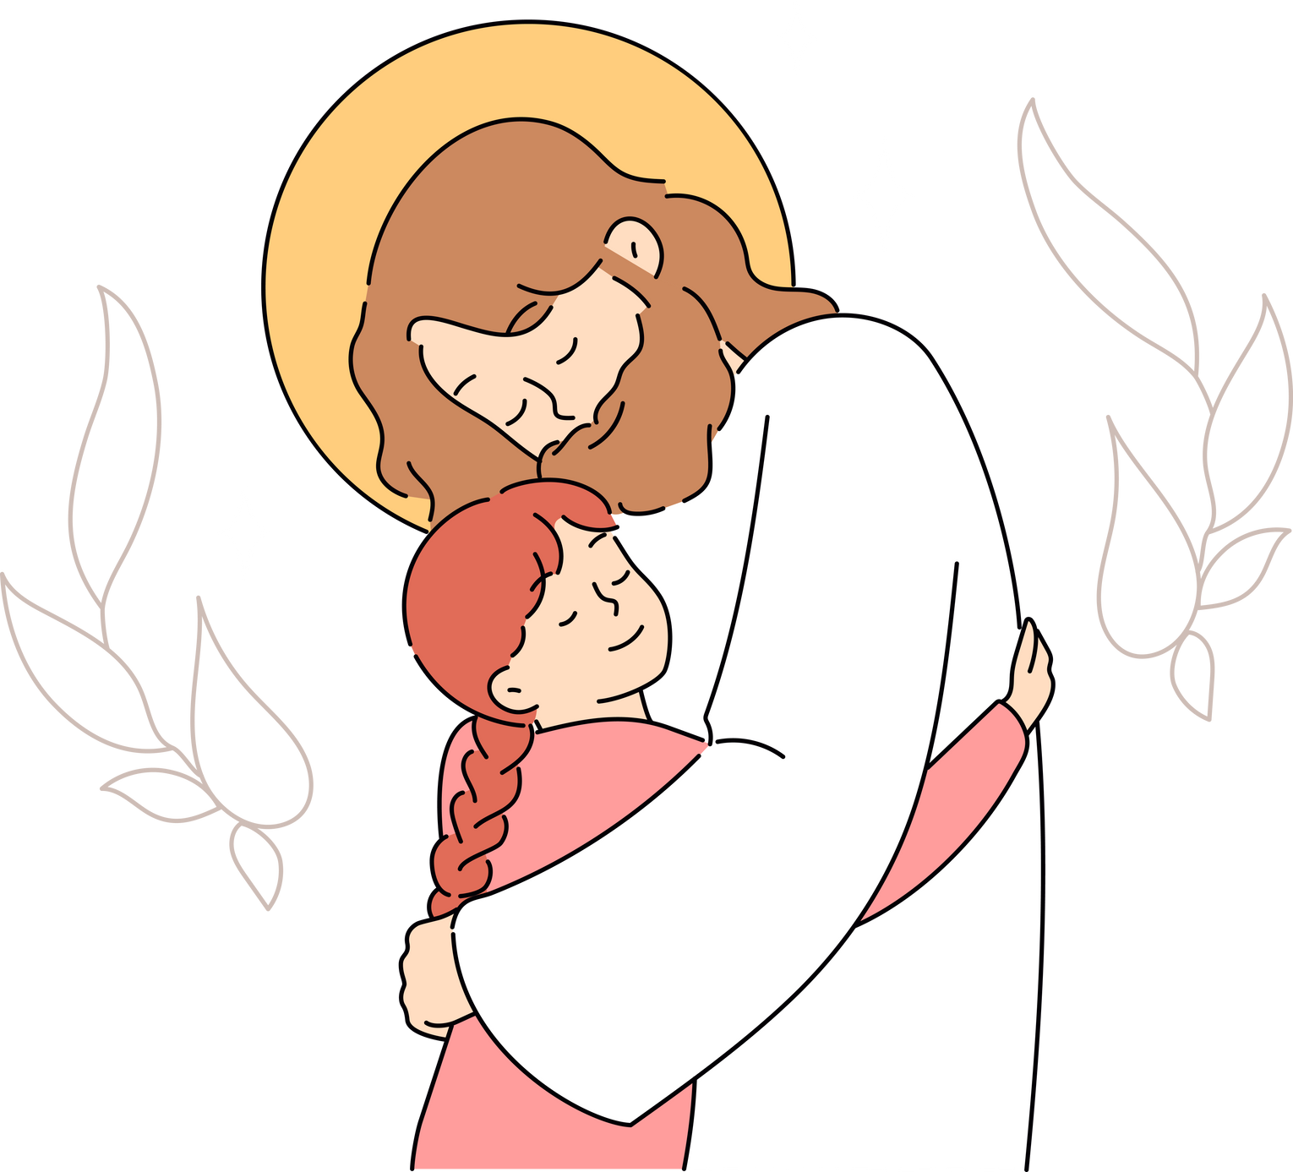

SHARING
MODULE 5
GOD’S LOVE
TOGETHER

Slide 2




HOW CAN YOUR FAMILY SERVE GOD TOGETHER?
When we listen to God together, our team becomes a super team because God is leading us! He is the best team leader ever!
Now imagine what happens when our super team begins praying for our neighbors, classmates, and friends. When we start reading the Bible together and look for ways to love others—like sharing meals with friends who need encouragement—God moves in amazing ways!

Slide 3


Slide 4

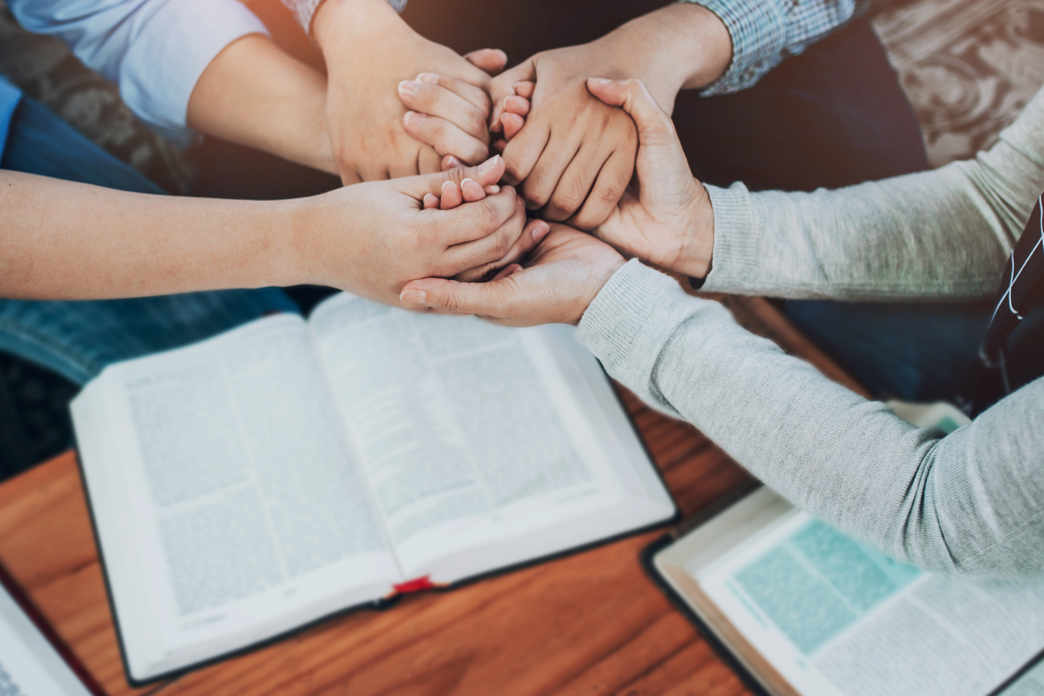



WHEN FAMILIES LOVE JESUS, THEY CAN DO AMAZING THINGS TOGETHER, LIKE:
  PRAY WITH EACH OTHER

Slide 5

WHEN FAMILIES LOVE JESUS, THEY CAN DO AMAZING THINGS TOGETHER, LIKE:
2. LEARN FROM THE BIBLE

Slide 6

WHEN FAMILIES LOVE JESUS, THEY CAN DO AMAZING THINGS TOGETHER, LIKE:
3. ENCOURAGE ONE ANOTHER

Slide 7
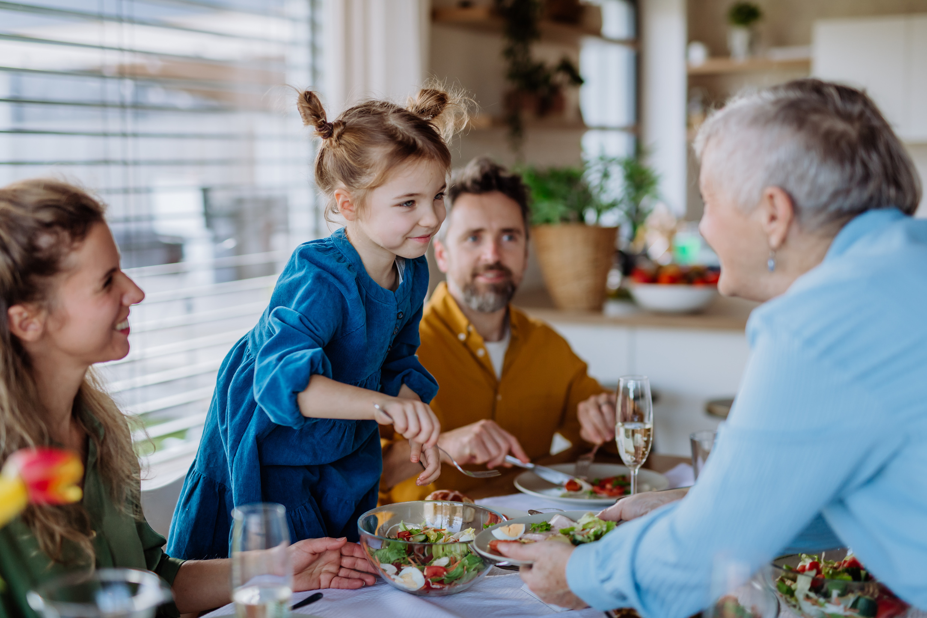
WHEN FAMILIES LOVE JESUS, THEY CAN DO AMAZING THINGS TOGETHER, LIKE:
4. SERVE THE WORLD AROUND YOU

Slide 8






JUSTIN’S STORY
You’ve met Justin in our previous module. Justin is on the autism spectrum, and he shares God’s love through writing encouraging notes and cards. But did you know his family plays a big part in this ministry?

Slide 9


Slide 10





HOW JUSTIN’S FAMILY SERVES TOGETHER
WORSHIPING TOGETHER
They invite God’s presence through singing and praising Him.

Slide 11





HOW JUSTIN’S FAMILY SERVES TOGETHER
PRAYING TOGETHER
They read Bible stories about how Jesus loved everyone He met, learning to follow His example.

Slide 12


HOW JUSTIN’S FAMILY SERVES TOGETHER
ENCOURAGING JUSTIN
When Justin feels stuck or shy, his family cheers him on, reminding him of his unique gift to bring hope.
By supporting each other, Justin’s family listens for God’s voice—together. They’re a living example of a family on a mission!

Slide 13



Think of one way your family can share God’s love together

Slide 14

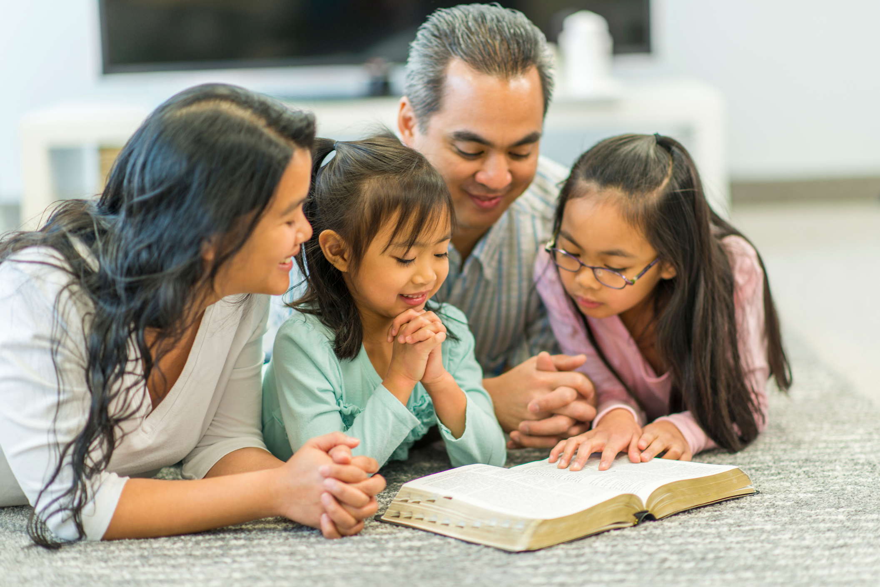

HOW DOES YOUR FAMILY HEAR GOD’S VOICE?
FAMILY DEVOTIONS:
Pick a Bible story and read it together. Discuss what it might mean for your family.

Slide 15
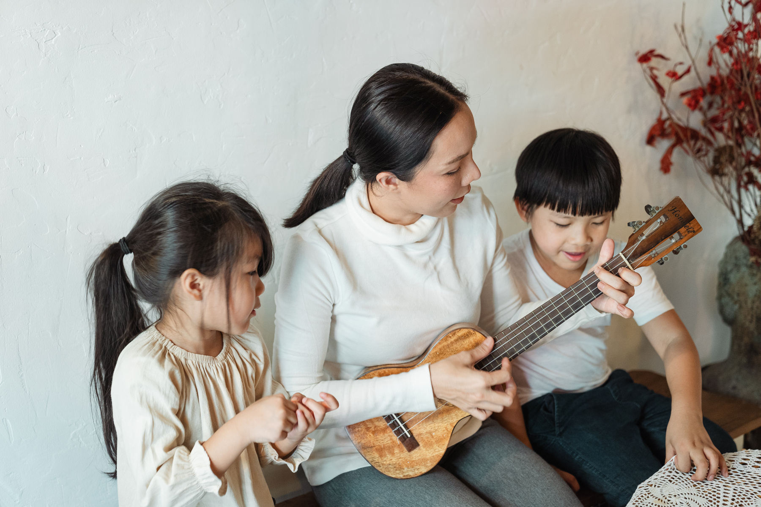
HOW DOES YOUR FAMILY HEAR GOD’S VOICE?
WORSHIP TIMES
Whether it’s singing or just playing music, worship can open our hearts to God’s voice.

Slide 16

HOW DOES YOUR FAMILY HEAR GOD’S VOICE?
GROUP LISTENING PRAYER
After each person shares a need or question, spend a quiet moment listening. Sometimes God speaks through a picture, a word, or a gentle thought.

Slide 17

HOW DOES YOUR FAMILY HEAR GOD’S VOICE?
SHARING TESTIMONIES
Talk about moments when you felt God leading you. Hearing each other’s experiences builds faith and unity.

Slide 18




HERE’S YOUR CHALLENGE: BECOME A FAMILY ON A MISSION!
ACTION STEP 1: MAKE A FAMILY MISSION PLAN
DONE
Use the Activity Sheet: Download or create a simple list of ways to serve and pray for others. Ideas :
  Praying for five neighbors or friends.
  Writing encouraging notes or verses.
  Doing a small act of kindness, like helping a classmate or picking up litter in the park.

Slide 19



HERE’S YOUR CHALLENGE: BECOME A FAMILY ON A MISSION!
ACTION STEP 2: HAVE A FAMILY MEETING
DONE
Pick one or two activities you can do together this week.
Pray and ask God :
“Who needs our love right now? How can we help them?”

Slide 20


HERE’S YOUR CHALLENGE: BECOME A FAMILY ON A MISSION!
ACTION STEP 3: SHARE WHAT GOD SAYS
DONE
If someone in your family senses a specific idea (like “make cards for the teacher”), go for it!
Keep track of what God shows you and celebrate the results.

Slide 21






CONCLUSIONS
YOUR FAMILY IS A POWERFUL TEAM IN GOD’S KINGDOM—YOU ARE CHAMPIONS! TOGETHER, YOU ARE SHARING THE GREATEST SUPERPOWER IN THE WORLD: GOD’S LOVE!

Slide 22

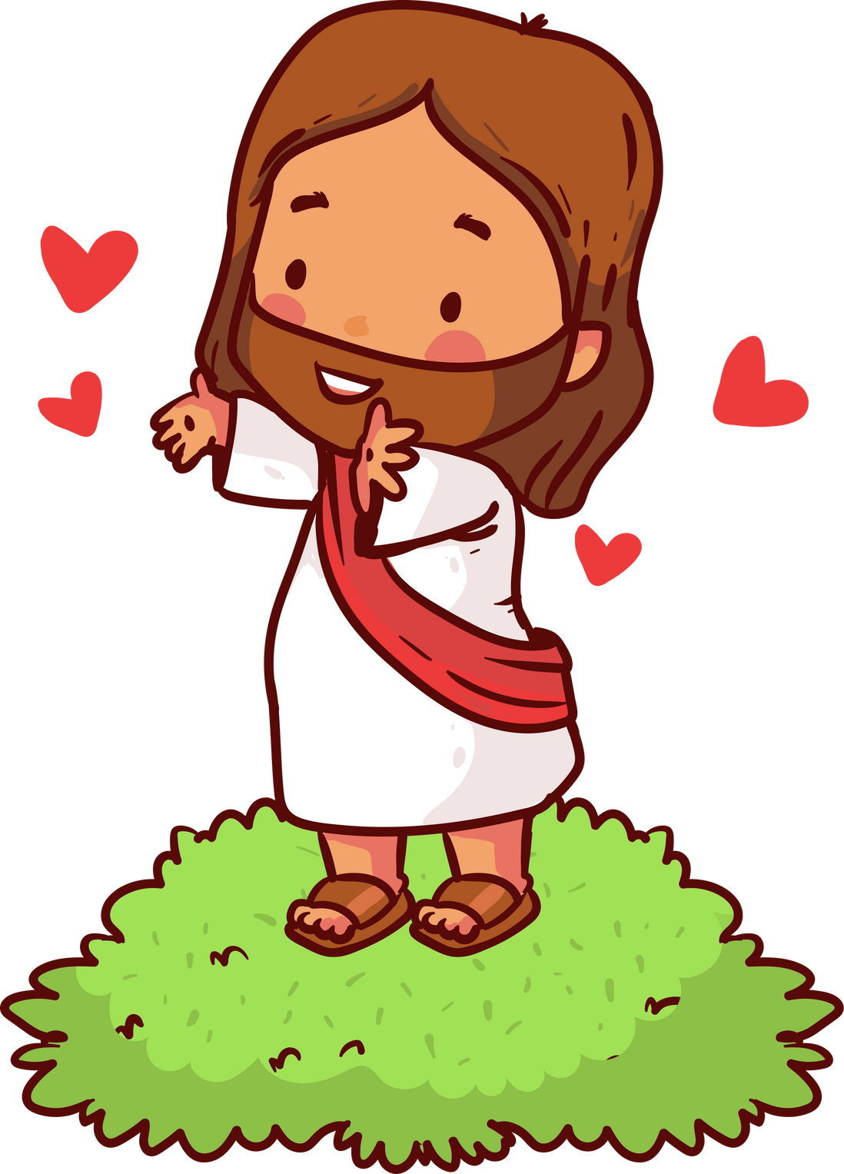

STAY TUNED FOR NEXT MODULE!
SHARE
GOD’S LOVE!

Slide 23



